Slide 1
UKSFA – Member Workshop
De Vere Cranage Hall, Holmes Chapel
Wednesday 18th June 2025

Slide 2
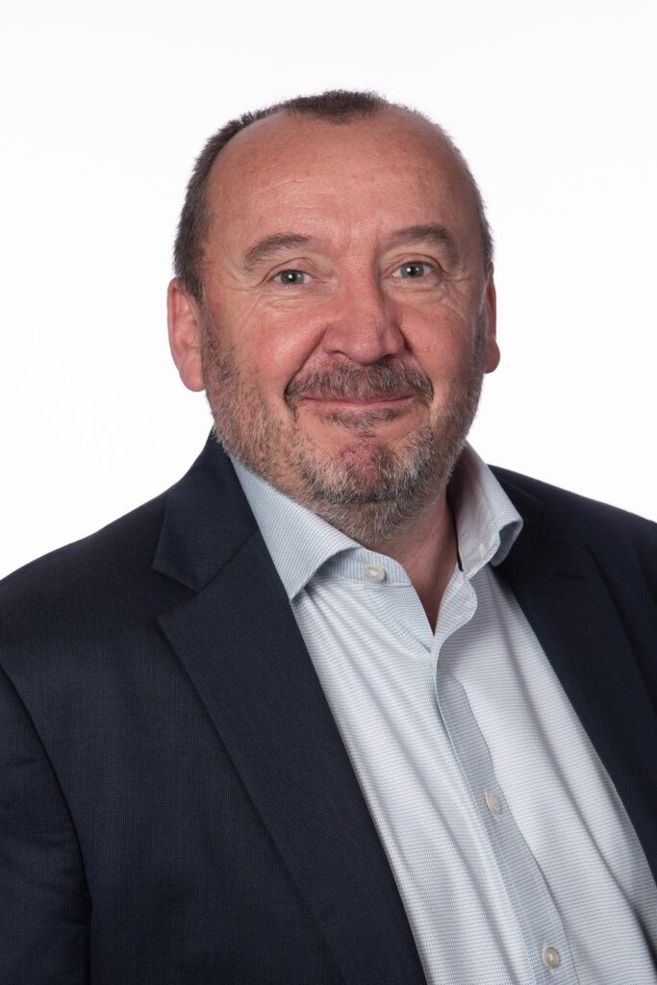
Andy Hall, Chair UKSFA
Welcome!

Slide 3



Thank you to our sponsor
Use shapes for pull-out text in the

Slide 4

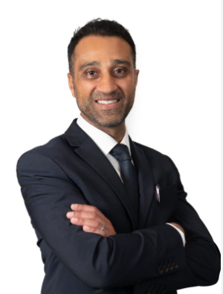
Cathie Clarke & Adnan Zeb Khan, UKSFA
Aims of the Workshop: Legislative Landscape

Slide 5

In the words of the great Billy Ocean…
When the going gets tough
The tough get going, tough, tough, huh, huh, huh
When the going gets tough, the tough get ready
Yeah, tough, tough...
I got something to tell you
I got something to say
I'm gonna put this dream in motion
Never let nothing stand in my way
Notes:
We’re going through tough times – in business and in life - but as the great man said – “when the going gets tough, the tough get going!”
I might be showing my age a little bit with quoting dear Billy… but I really believe that when life is challenging, we’re much better off coming together to tackle all those challenges and take advantage of the opportunities that doubtless arise.

Slide 6
Aims of the Workshop
In one of the toughest and uncertain economic environments that we’ve seen, we want to emphasize that it’s more important than ever for the flooring sector to work collaboratively to manage flooring waste more sustainably and to take control of its circular economy future
To consider initial results from existing and ongoing research into takeback and EPR schemes
Why is data crucial and to understand the challenges of data collection and consider how to overcome them
Understanding your challenges today and moving forward
To set next steps and refine the UKSFA Flooring Stewardship Strategy
Creating opportunities for industry-wide sharing, collaboration and knowledge exchange = greater understanding = design of industry solutions

Slide 7
Legislative Landscape & Other Drivers
LEGISLATION (Existing or Expected)
Ecodesign for Sustainable Products Regulation (ESPR- June 2024)
  Sustainability Requirements
  Digital Product Passports (DPP)
  Product Compliance
  Extended Producer Responsibility (EPR) - Alignment
  Green Claims Directive
Construction Product Regulation (CPR)
Emissions Trading Scheme (ETS)
Waste & Resources Strategy for England (DEFRA)
Other Drivers
Environmental Product Declaration (EPD)
Life Cycle Assessments (LCA)
UK Green Building Council
BREEAM
Increased demand for Take-Back, Reuse and Recycling Schemes
Government procurement (schools, hospitals, military housing, government estate)
Specifiers (architects & designers)
Client
Residential (homeowners)
Main contractors (commercial buildings)

Slide 8

Adam Thompson MP
Working in partnership with Government

Slide 9
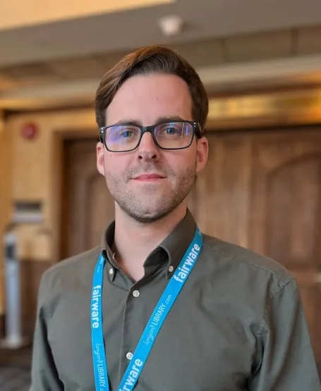
Jordan Girling, WRAP
A positive approach to EPR

Slide 10

Stéphanie Jacob, Valobat
Valobat EPR Scheme: Success & Challenges

Slide 11
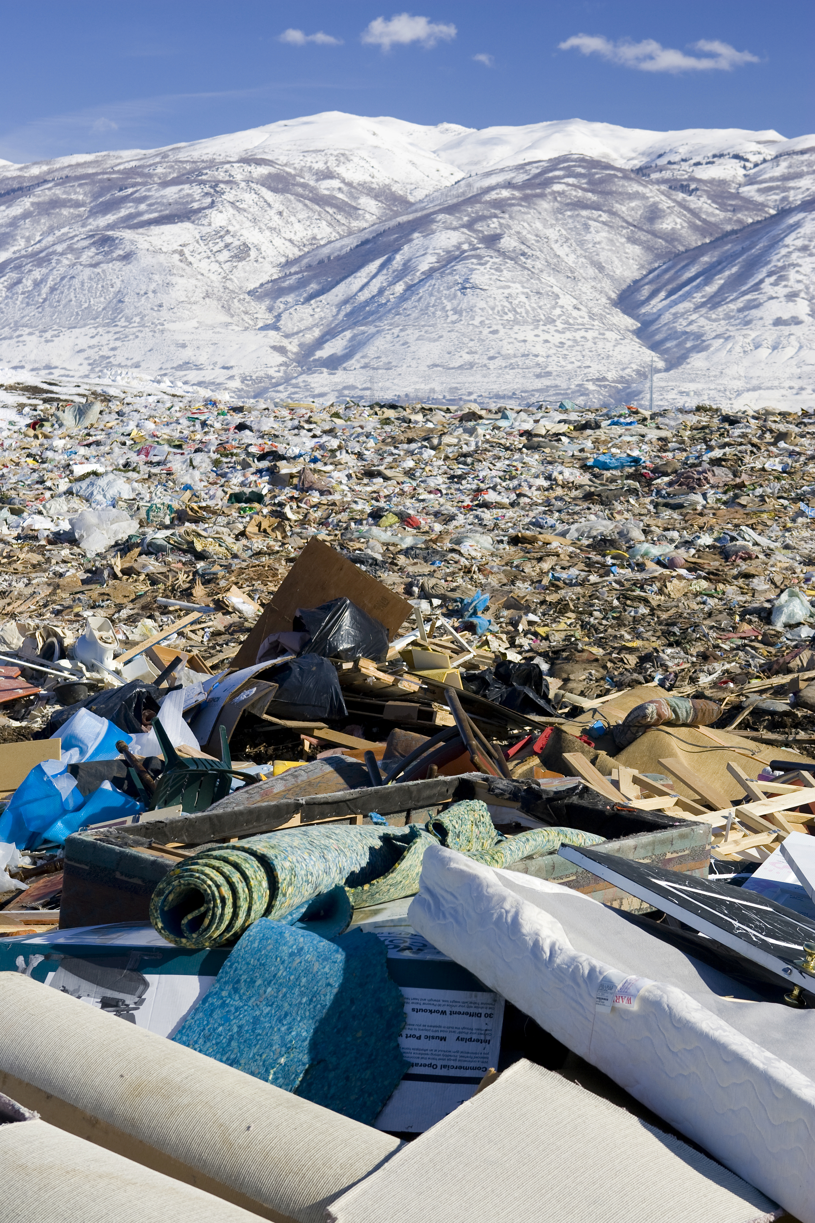
Q & A

Slide 12
Questions for presenters – for you to add to if you like
Adam
How influential are APPGs in developing government policy?
What other initiatives can the flooring sector get involved in to help raise our profile with government circles?
Jordan
Are industry-led schemes cheaper to run and operate compared with mandatory ones?
As it’s a voluntary scheme, what are the key benefits for those who join at the start and voluntarily?
How can you prevent the product fees from increasing along the supply chain?
What kind of independent auditing and enforcement is necessary?
Stephanie
How are the eco-modulated fee structures for flooring?
Is the current scheme over complicated, especially with it being so broad under Construction?
How do you collect the fees and how are these audited?
What is the plan for building new recycling facilities and how much of the fees are allocated?

Slide 13
Lunch in the Tempus Restaurant-Downstairs
See you back at 1pm

Slide 14

Max Goodliffe, Resource Futures
UKSFA TakeBack Resarch Project: Key Findings

Slide 15

Mike Dobson, UKSFA
Data is the Doorway to Success!

Slide 16
Data, data, data…
How big is the UK flooring market?
What is the split Residential/Commercial?
What is the average life cycle, by product?
What are the influencers in the different segments?
How much of the product is imported, and where from?
How much product is installed in new-build locations?
What happens at end of life?
Does each player have a WIIFM to be more sustainable?

Slide 17
Automotive Segment
Average square metres of textile flooring used per new vehicle?
20m2 per car, including mats, etc.
Total number of new cars sold in UK?
1.953m (2024)
Average weight of textile?
1.4kg per m2
Total new automotive flooring used in UK in 2024: 39m m2, 55,000 tonnes
Key questions: main players, materials used, end of life solutions, and so on

Slide 18
EPR – Household Waste Recycling Centres
Textile considered one of the main constituents of Bulky Household Waste
One of the key principles of an EPR scheme is that the supplier pays a levy to fund the end of life waste treatment
Household Waste Centres are the only end of life route funded directly by Government
Monies raised by an EPR scheme should therefore be shared by local authorities
However,…

Slide 19
Resource Efficient Data Waste Data Flow
In 2023, UK HWRCs (excl Northern Ireland) collected 22,906 tonnes of textile waste
This equates to roughly 6% of the total waste produced by the industry
Armed with this information, we can have a fact-based discussion with Government about how best to utilize the funds raised by an EPR scheme
Better understanding of the waste streams leads to the right proposals for the industry

Slide 20
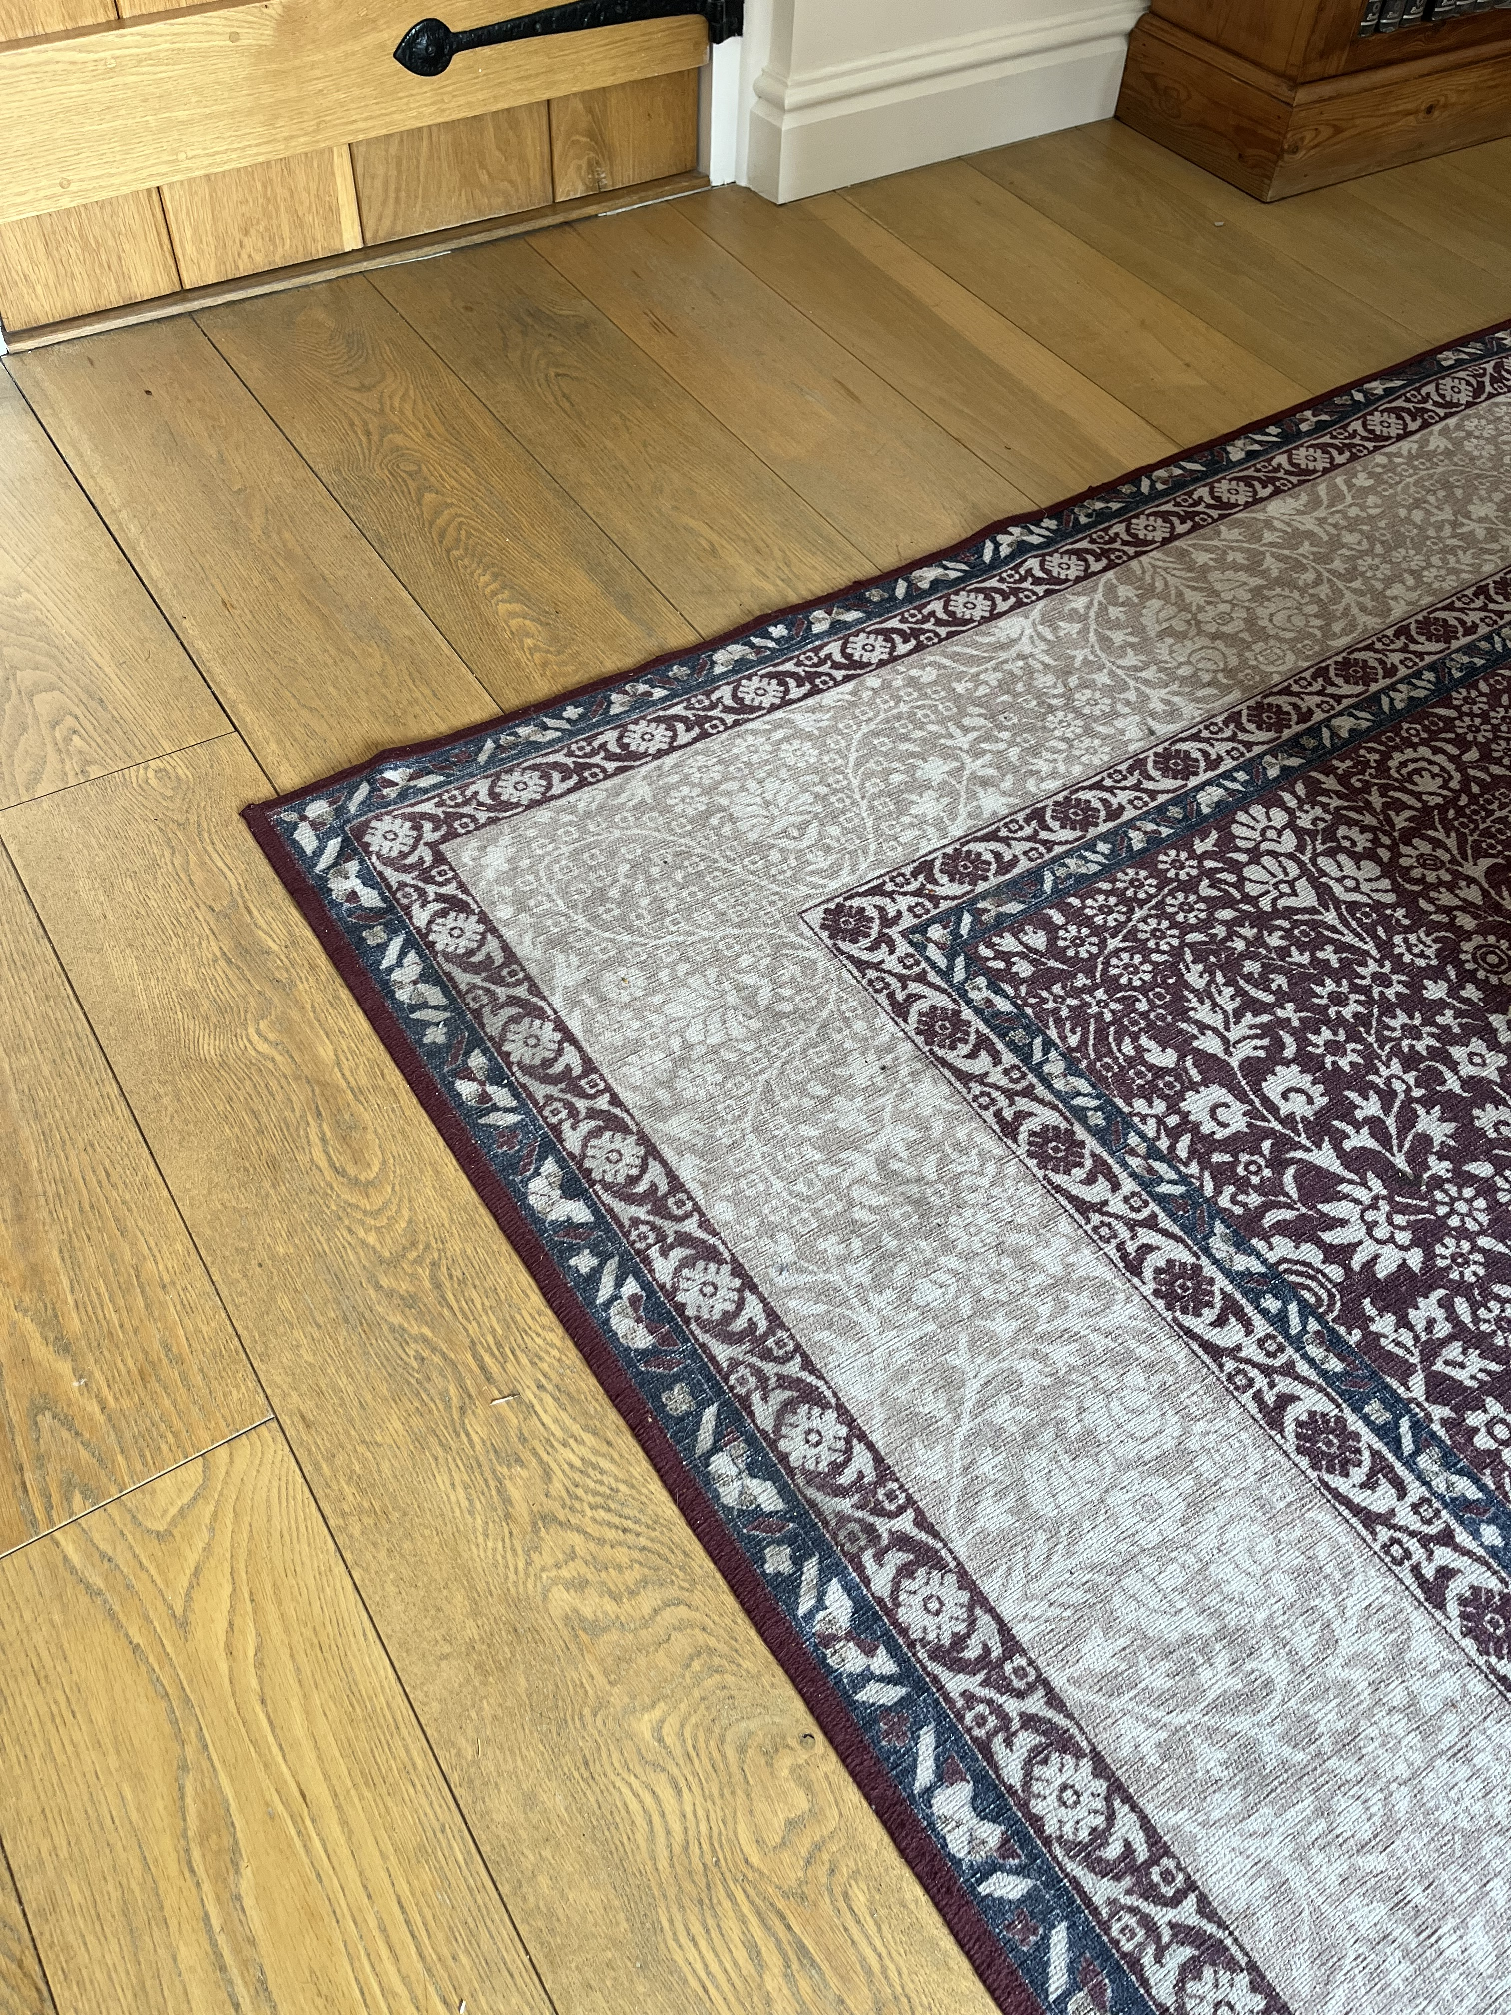
Information Needs to Be
Defendable
Accurate
Tailored to our needs
Always understandable

Slide 21
Q & A

Slide 22
Questions for presenters – for you to add to if you like
Max
How important is it to have an industry wide TBS?
Who is best placed to manage such scheme, is it the companies that sell the products or should it be done by an independent organisation?
What are the biggest challenges you are facing when arranging discussions with scheme operators?
Mike
How important is data going to be in the future for the flooring sector?
What do you see as being the challenge from government or other agencies if we don’t have credible data?
How can data help create value from waste products?
???

Slide 23
Cathie Clarke & Adnan Zeb Khan, UKSFA
Mapping Out the Next Steps – The UKSFA Stewardship Strategy

Slide 24

Next 12 months focus
Use shapes for image cropping
Build on the findings of the TBS and EPR projects
Support existing reuse and recycling infrastructure
Identify new recycling processes for other flooring types
Continue progressing with the working groups
Identify new working groups
Continue lobbying and involvement in consultations and CE taskforce meetings
Work with existing members to introduce UKSFA to the resilient flooring sector
Adopt all the actions and outcomes of today’s workshop

Slide 25

Afternoon Tea & Finish
Drinks Reception, 6pm on the Baird Suite Patio

Slide 26
Use shapes for pull-out text in the
Thank your attendance and contribution

