Slide 1

Dr Bob Peoples – Carpet America Recovery Effort

Slide 2


UK Sustainable Flooring Alliance
Annual Conference
Challenges & Opportunities
July 1, 2026
Solihull, U.K.
© CARE, Inc.
SFA-UK July 2026

Slide 3

Agenda
It's time to learn from the past and move forward into the future
Introduction
Challenges
Post-consumer content & Back Stamping Protocol
CARE National Survey
California Update
New York Update
Wrap-up and Q&A
3
© CARE, Inc.

Slide 4

Carpet America Recovery Effort
Created January 2002 (non-profit)
Memorandum of Understanding (MOU)
        Set rates and dates (targets)
    Issue annual report
    Create third-party organization
CARE California LLC (2026)
25 years
4
© CARE, Inc.

Slide 5
Carpet America Recovery Effort
25-year mission
Facilitate the carpet industry-lead initiative to find market-based solutions for the reuse and recycle of post-consumer carpet.
5
© CARE, Inc.
Notes:
A revised mission is under development

Slide 6
Perspective
6
© CARE, Inc.

Slide 7

“It was strange we came to study the moon, and what we really discovered was the Earth.”
Cmdr. William Anders – “Earthrise”
Apollo 8
Dec. 24, 1968
7
© CARE, Inc.
Notes:
I want to begin where I have ended in the past. This is the famous Apollo 8 photo dubbed Earthrise in 1968. Earth Rise = Sun Rise = beginning of a new day.
We still have work to do as very few truly understand just how fragile this Spaceship Earth really is!

Slide 8
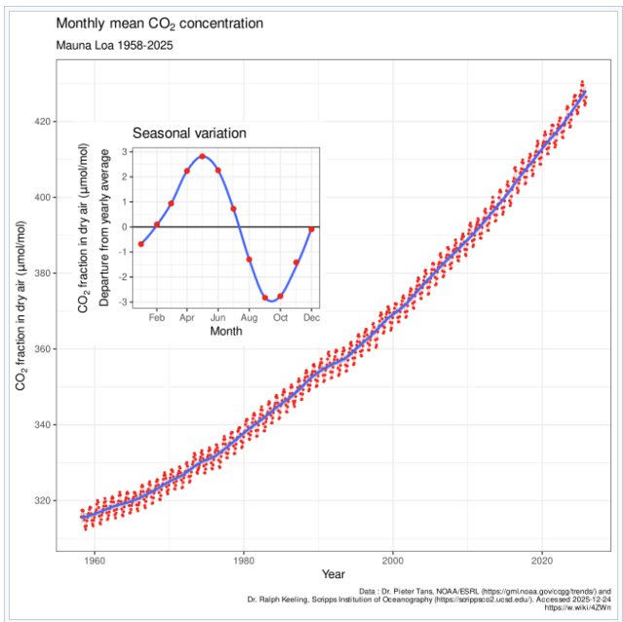
Challenges
Climate → CO2, El Nino (amplification)
Water scarcity
Pollution : air, water, land
  microplastics, nanoparticles, tissue inclusion, POPs
Virus resurgence : temperature & travel
Population growth
Global unrest
Future impact of AI
Complexity & consequences
More …….
CO₂ > 420 ppm
https://en.wikipedia.org/wiki/Keeling_Curve
8
© CARE, Inc.

Slide 9

Magnitude of Plastics Challenge
Massive virgin plastic production: >445 million mT/year (2025)
54 kg (118 lbs.) per year for every human being
2050 projection: 590 million mT annually (83 kg.)
Recycle rate <5%
Technology evolution - pace
Education
Invested capital
Transition capital
Macroeconomic drivers / changes
https://www.statista.com/statistics/664906/plastics-production-volume-forecast-worldwide/#:~:text=Plastic%20production%20forecast%20worldwide%202025%2D2050&text=It%20is%20projected%20that%20the,almost%20370%20million%20metric%20tons.
9
© CARE, Inc.
Notes:
Why are we here? I share this slide today because the dynamics of our world are evolving as we expect. It is because there continues to be a global challenge around waste generation & plastics are a major contributor!
While organics are #1, they are biodegradable in principle. But when buried in an anaerobic landfill, takes much longer. By 2050 we will produce 183 lbs. of plastic/person (2026 population 8,297,624,527 )

Slide 10
Education
Recycling foundational to solving our global plastics waste problem
Chemical recycling essential to tackling plastics waste problem
Mechanical recycling key to chemical recycling
People lost in details of understanding technology & terminology
Plastic recycling works! Proven technology exists, but
  Economics remain a challenging hurdle
Certifications & Mass Balance – important issues
Must recommit to helping decision makers understand
Will save: time, money, frustration, delays, reputations
It will enable progress
10
© CARE, Inc.
Notes:
Time does not permit us to go into the details of the certification & MB challenges. I will share a few thoughts, but know this is an intense and on-going important need.
Let’s talk about the rate of change we are living with.

Slide 11
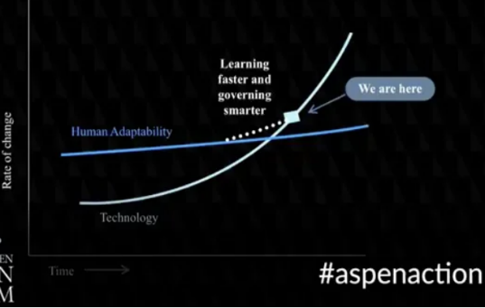
Legislation: accelerating faster than business’s ability to adapt & implement
Learning faster and governing smarter
Human Adaptability
Rate of Change
Technology
Time
https://workingnation.com/thomas-friedman-technology-accelerating-faster-ability-adapt-can-catch/
11
© CARE, Inc.
Notes:
Source: Resnick Aspen Forum talk by Thomas Freeman, August 2017
While this is a generic technology evolution concept, I am applying it to our statutory challenges: good intentions, but lack understanding

Slide 12

Post-Consumer (carpet) Content*
Intent - drive demand
CA 5% by January 2028
NY 10% by 3031
Expect CA to align with NY
Pathways to achieve (content, redesign)
Availability of materials (geographic considerations)
Technical hurdles
Textile & Packaging “competition”
Back stamping by January 1, 2027 (CA)
Unrealistic timelines?
* CA law AB 863
12
© CARE, Inc.
Notes:
Almost all the capacity to depoly is SE Asia at this time. Redesign for separation and minimize blends.

Slide 13
Accounting & Certification – How To?
Claims
  Physical content vs. Attributed claim
Chain-of-Custody Models (Country of Origin & Content)
  Mass Balance
    Rolling average percent model
    Credit method : attribution
      Proportional
      Non-proportional
    Book-and-Claim
“Accounting” – CARE strategy
13
© CARE, Inc.
Notes:
CARE intendeds to identify a list of organizations that do such certifications. Any manufactures who certifies with ne of those approved companies is accepted. CARE will work to validate certifications via audits.

Slide 14
Back Stamping
A new requirement under statute for California & New York
Recycle Need
Consistency
Capability
Efficiency
Certification
14
© CARE, Inc.

Slide 15


Other Considerations
Existing Requirements:
  Textile Fiber Products ID Act
  FTC regulations
  FHA regulations
  Other requirements?
  Differences: Residential and Commercial requirements
Protocol issued (Joint Task Force)
15
© CARE, Inc.

Slide 16
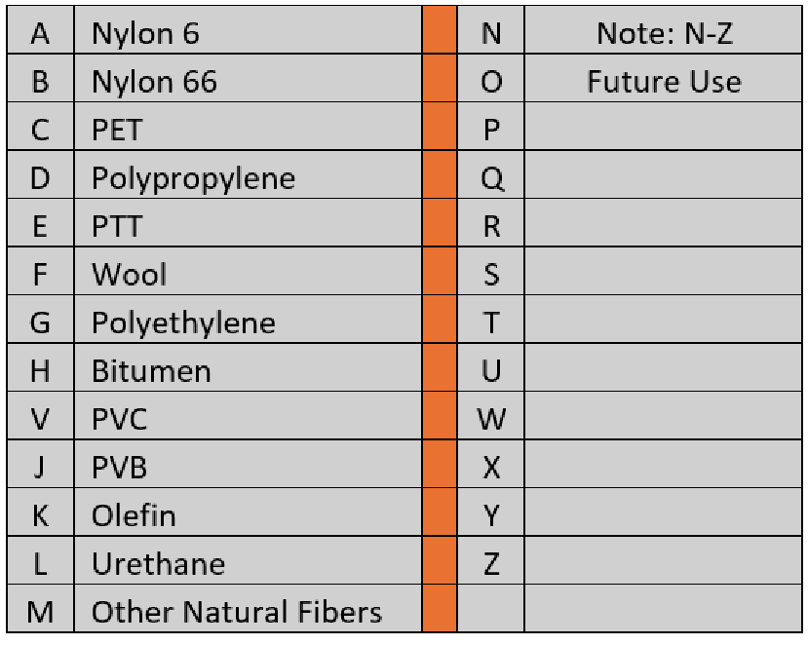
Protocol & Polymer codes
Specified Information
Broadloom
Repeat pattern: width & run
Font size
Durability
Carpet Tile
25% of tiles
< Manufacturer, Date, Face, Backing >
Manufacturers using polymers not included in the codes listed should alert CARE or CRI so this Appendix can be updated.
16
© CARE, Inc.
Notes:
This protocol has been shared with UK-SFA so that you are aware of our efforts in the U.S.

Slide 17
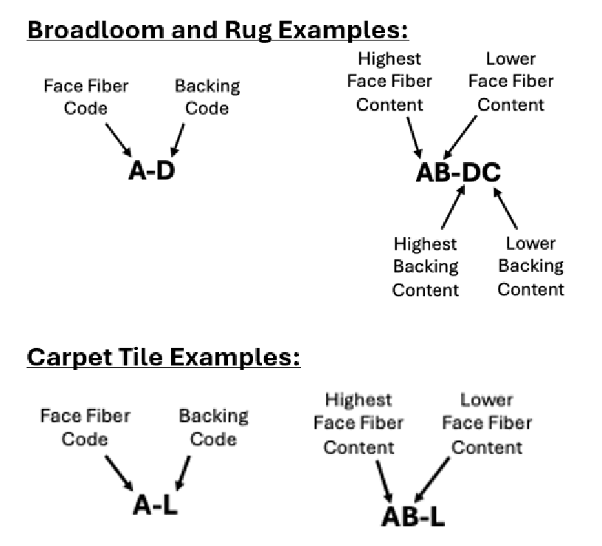

Examples
PA6 & PP ::
Mnfg-Date-A-D
PET/PA6 & PP/PET ::
Mnfg-Date-CA-DC
1 inch, 16 bit print head
(Non-protocol print example)
17
© CARE, Inc.

Slide 18
CARE National Survey
2025 DRAFT Results
18
© CARE, Inc.

Slide 19

Purpose of National Survey
Reintroduction after COVID Pandemic: reporting was stopped
Reestablish a baseline of carpet recycling activity nationally
Work to fill in missing years: 2020, 2021, 2022
Survey sent January 7, and concluded on February 6, 2026
Analysis added CA information to national survey
Mass balance approach employed
13 responses
Thank you to our participants!
19
© CARE, Inc.
Notes:
At one time CARE had as many as about 64 registered carpet recyclers prior to the 2008 financial crisis. Today we have about 20 individual companies, and it varies monthly depending on who is and is not shipping.

Slide 20
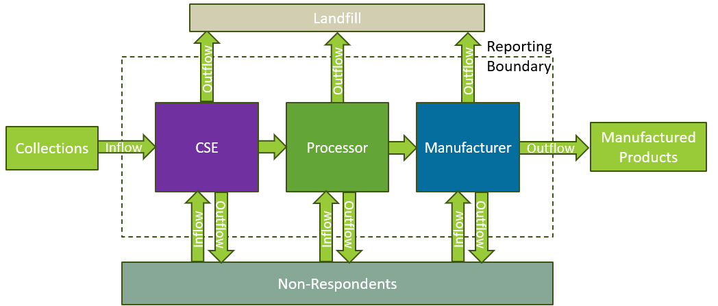
Mass Balance Accounting
Collector
20
© CARE, Inc.
Notes:
CARE used an approach well know as the Sankey diagram to show mass balance analysis.
This is similar to energy flow balance you may have seen.

Slide 21
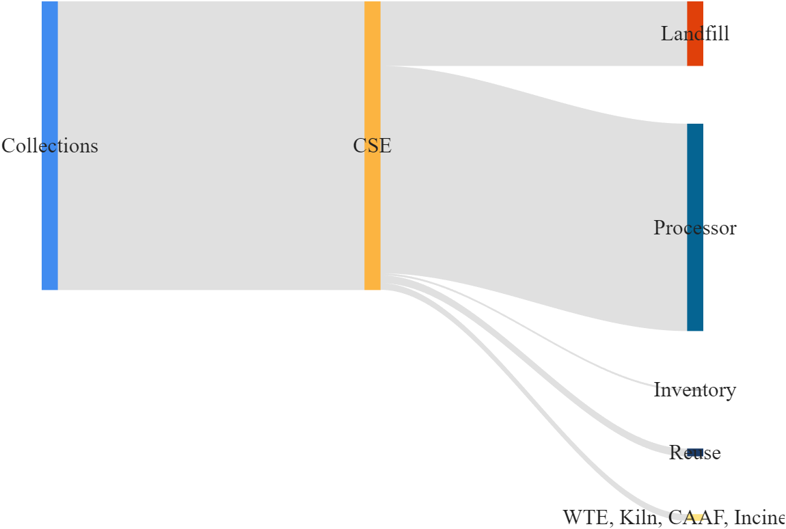

Sankey Model Overview
CSE
Vertical colored bars indicate different entities in recycling process
Mass flow is represented by vertical grey bands
Relative magnitudes represented by thickness of band
Imbalance of flow represented by a larger colored bar compared to incoming or outgoing grey band
Processor
conceptual
Done for each stage: Collection-Processing-Manufacturing
21
© CARE, Inc.
Notes:
Quick: provides for an easy visual approach to the mass balance results. We do a separate Sankey for the collectors, processors, and manufacturers. Note – not everyone in the ecosystem reports.
In the interest of time, I will not show the individual stages, but rather the integrated results.

Slide 22
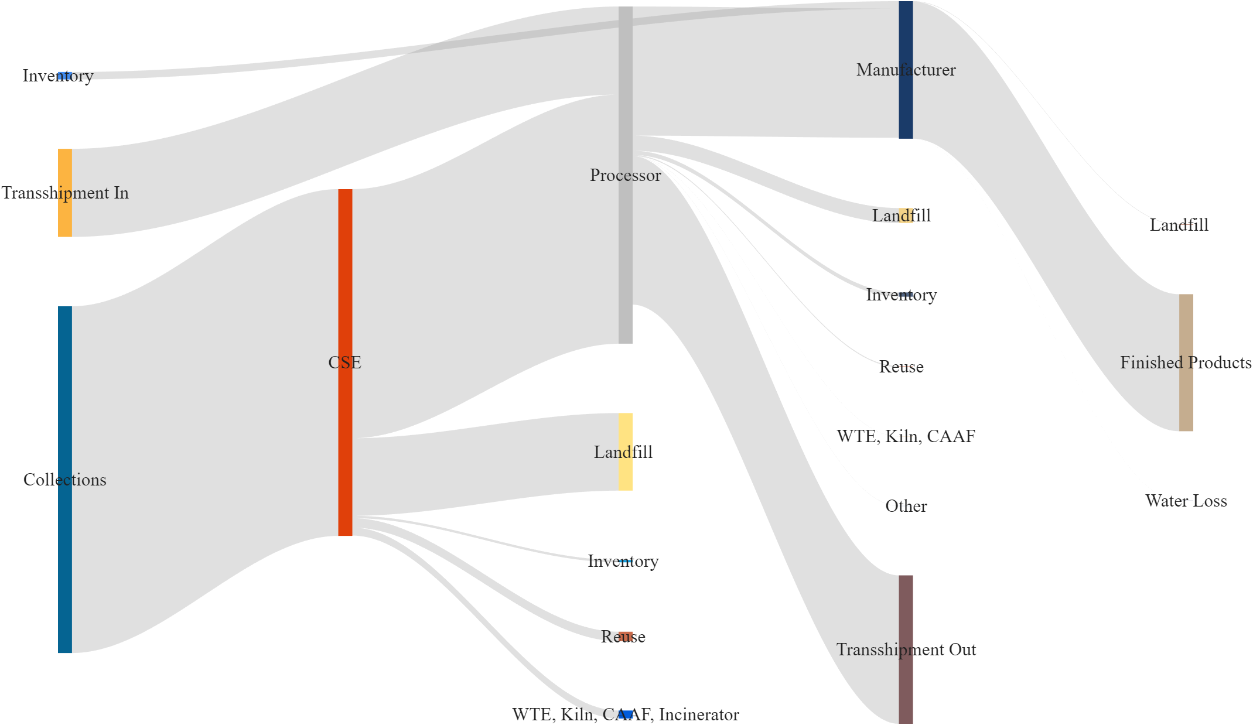


2025 National Mass Flow Sankey (integrated)
Manufacturer
Processor
8%
Collector
(Shipped to non-participating company)
22
8% out of 122M pounds (<10M lbs.) – outside reporting network by choice
© CARE, Inc.
Notes:
Integrated means inclusive of CA data.

Slide 23
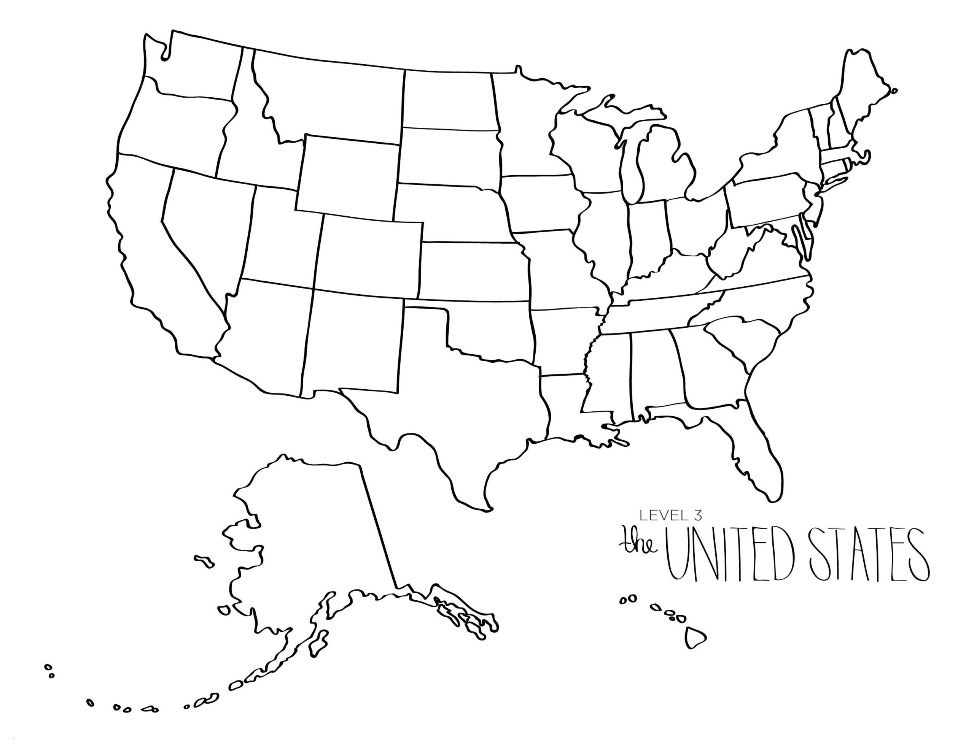

Preliminary Results
Metric | United States* | California
Discards | 3,029 billion lbs. | 184.5 million lbs.
Gross Collection | 122.2 million lbs. | 78.5 million lbs. (64%)
Recycled Output | 74.1 million lbs. | 67.9 million lbs. (92%)
Yield (RO/GC) | 60.6% | 86.5%
Recycle Rate (RO/Discards) | 2.5% | 36.8%
* Includes CA
23
© CARE, Inc.

Slide 24
2025 Breakdown of Output
Destination | Associated Mass (Pounds) | Percent (2023) | Percent (2024) | Percent (2025)
Landfill | 32,791,000 | 38.0% | 32.6% | 29.9%
Finished Materials | 48,283,000 | 38.1% | 40.9% | 44.0%
PC4 | 18,890,000 | 15.1% | 20.3% | 17.2%
Reuse | 6,886,000 | 6.0% | 5.1% | 6.3%
WTE, Kiln, CAAF | 2,849,000 | 2.8% | 1.1% | 2.6%
Reuse
PC4
Landfill
Finished Matl’s
PC4 : post-consumer carpet calcium carbonate
RO = 67%
24
© CARE, Inc.
Notes:
You can see we do take credit for the recovered PC4 which but only since it has value from CA PCC due to 17 cent/lb. subsidy.
Reuse is virtually all carpet tile, which is now starting to grow through a special program we have implemented and hope to scale nationally.

Slide 25
Conclusions
Good progress closing balance for the Collector, Processor, and Manufacturer levels
Balances between respondents did not have perfect agreement due to entities outside the network, but were small compared to the scale of mass flow (8%)
Confidence in estimates for 2020-2022
Recyclable fraction has gradually increased year over year
Report expected this fall
25
© CARE, Inc.

Slide 26
California Update: Q1 2026 Results
California Carpet Stewardship Program Approved Results
26
© CARE, Inc.

Slide 27
AB 2398 Performance Trends (millions of pounds)
Table Note: 2015 – 2025 data represents the quarterly average during the year.
27
© CARE, Inc.

Slide 28
Recycling Rate Trend
2026 RR Target = 41%
YTD
Recycling Rate = Recycled Output / Discards
Recycling rate increased by an average of 10.8% year over year from 2015 to 2026.
© CARE, Inc.

Slide 29
Sales by Quarter
First time sales drop below 11M yd2
-8%
-7%
-9%
-10%
© CARE, Inc.

Slide 30
Sales by Year and Percent Change
2025 Sales were 7.6% below 2024
© CARE, Inc.

Slide 31
Carpet Mill Sales by Face Fiber
© CARE, Inc.

Slide 32
Summary of Expenses
Subsidies paid in CA = 87%
Union Grants
Note: All data from Finance Director confirmed 5/18/26
© CARE, Inc.

Slide 33
Drop-Off Site Program Update
California Carpet Stewardship Program Q1 2026 Approved Results
© CARE, Inc.

Slide 34
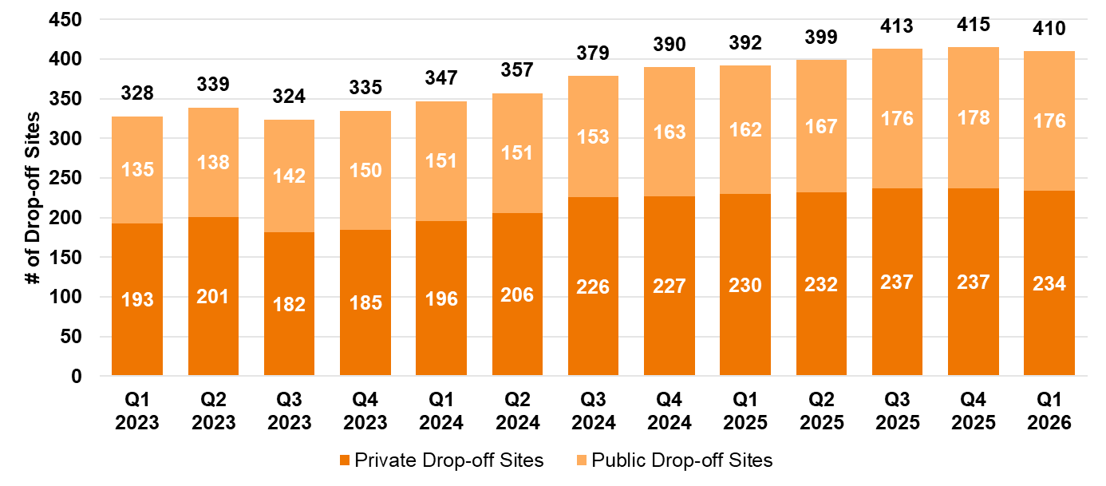
Total Drop-off Sites
Note: Public drop-off site data includes FOUR regional distribution sites.
© CARE, Inc.

Slide 35
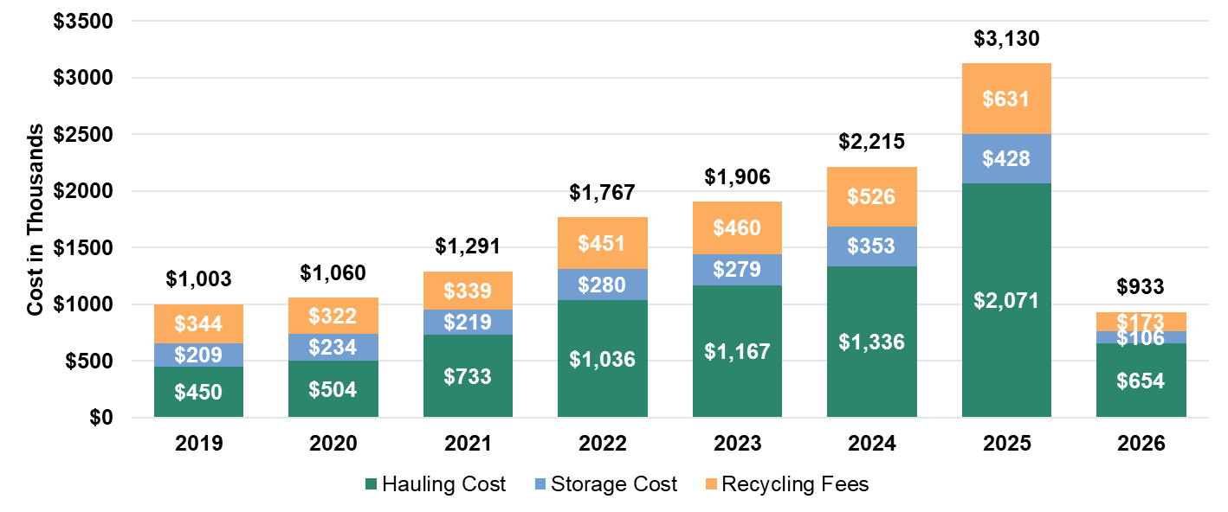
Annual Cost Comparison
% of 2025 Total Program Costs: Hauling: 70% | Storage: 11% | Recycling Fees: 19%
© CARE, Inc.

Slide 36
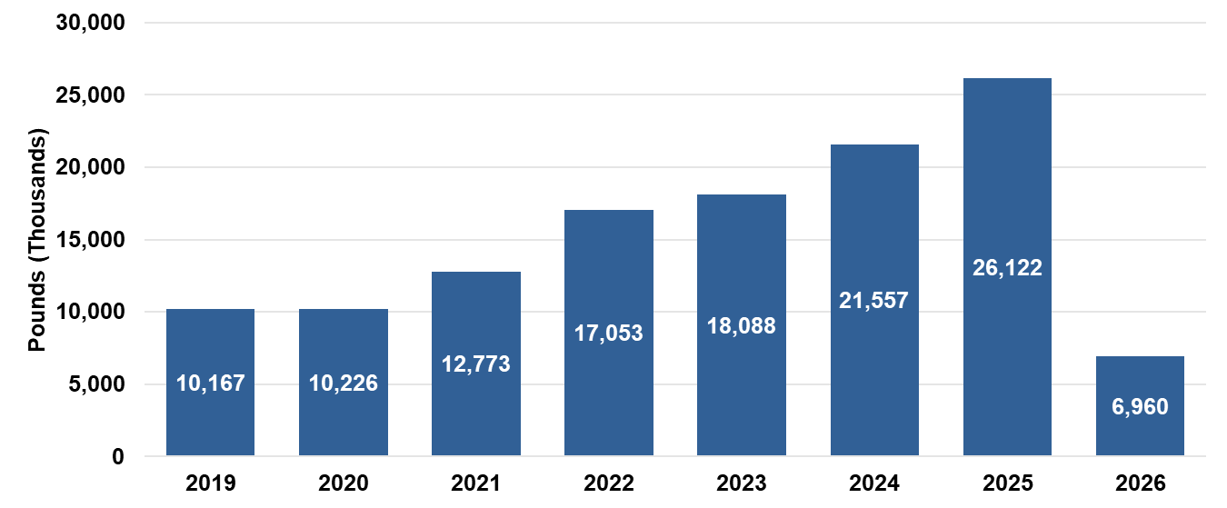
Material Collected by CARE Drop-Off Sites (Annual)
2026 lbs. collected: 27% of total 2025 lbs. collected
Q1 2026 lbs. collected: 6% decrease from Q4 2025 lbs.; 43% increase from Q1 2025 lbs. collected
© CARE, Inc.

Slide 37
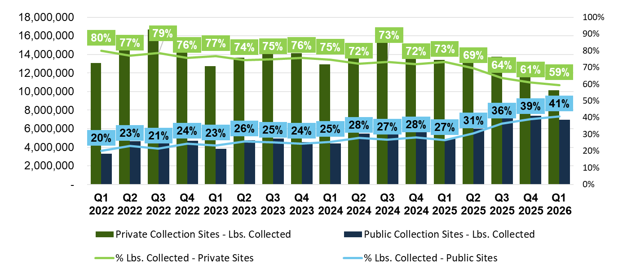
Private vs. Public Collection Sites
© CARE, Inc.

Slide 38
Subsidies Paid Trend
Beginning 5 cents/yd2
Today
Broadloom $1.05/yd2
Carpet Tile $1.49/yd2
© CARE, Inc.

Slide 39
Table 3-2. Summary of Program Performance Goals and Metrics, 2026
Performance Progress as of Q1 2026
Goal | Metric | Additional Notes | Full Year 2026 Goal | YTD Q1 2026 Status | YTD Q1 2026 Assessment | YTD Q1 Commentary
1 | Recycling Rate | Achieve a 31% recycling rate for post-consumer carpet in 2023, increasing annual goals in each year of the Plan, and 45% recycling by December 31, 2027. | 41% | 37.8% | In process (Challenging) | We anticipate full compliance by the end of the year.
2 | Recycling Efficiency Rate (formerly Yield) | Achieve a recycling efficiency rate of 75% annually for 2023 through 2027. | 75% | 88.5% | On Track
3 | Collection Rate | Achieve a collection rate of 41% in 2023, increasing annual goals in each year of the Plan, and 60% collection by December 31, 2027. | 55% | 42.7% | In process (Challenging) | We anticipate full compliance by the end of the year.
4 | Public Access to Drop-off Sites (Collection Convenience) | Increase public access to drop-off sites with a minimum of one per county and one site per 500,000 residents in 2023, increasing annual goals, and one site per 375,000 residents by December 31, 2027. | One site per 400,000 residents in each county, (minimum of one per county) | 98.3% | In process (Challenging) | Cheryl D: 57 out of 58 counties, missing Alpine County, however we anticipate full compliance by the end of the year.
5 | Flooring Professional Proximity: % of residents within 15 miles of a location that accepts carpet from all flooring professionals | Increase flooring professional proximity such that 75% of residents are within 15 miles of a public drop-off site in 2023, increasing annual goals, and 90% by December 31, 2027. | 86% | More than 90% live in a Census tract located all or partially within a 15-mile radius of a location that accepts carpet from all flooring professionals | On Track | Cheryl D: No change from previous quarter.
6 | Reuse of PCC (% of Recycled Output) | Increase the reuse of post-consumer carpet. | 2.0% of Recycled Output | 6.7% | On Track
7 | Gross Collection (thousand pounds) | Increase the collection convenience for the recycling of post-consumer carpet and increase the collection of post-consumer carpet for recycling. | 90,000 | 17,118 | In process (Challenging) | Annualized Q1 2026 is 68.5M, however we push for full compliance by the end of the year.
8 | Disposal of PCC (thousand pounds) | Reduce the disposal of post-consumer carpet. | 94,000 | 24,942 | In process (Challenging) | Annualized Q1 2026 is 99.8M, however we anticipate full compliance by the end of the year.
9 | Processor Capacity (West Coast) | Increase processor capacity, including processor capacity in California. | 143 million pounds capacity | Projected at 106.4m | In process (Challenging) | Actual 2025 West Coast Processor Capacity was 120.1M. Projected 2026 based on survey is driven by Aquafil reductions.
10a | Recyclability: Recyclable PCC Types | Increase the recyclability of carpet. | Ensure program capacity to recycle 78% of PCC types | Projected at >78% | On Track | Abbie B: Re-running waste characterization in Aug 2026 and expect the 2025 97% recyclability percentage will change based on new sample but not expected to fall below the goal.
10b | Recyclability: Innovation & Design (I&D) Grants | Increase the recyclability of carpet | Award 2 I&D grants | Projected between 2 & 3 for 2026 | On Track | Abbie B: On track to meet at least 2 (potentially 3) I&D grants in 2026. We are selecting awardees this month.
11a | Markets: New Products | Expand and incentivize markets for products made from post-consumer carpet. | 3 new products; 114 total products | 132 total products as of Q1 | On Track | Rob T: might see some attrition later this year, which could potentially make meeting the 2026 goal difficult. Will update as things move and open up. FYI: Engineered floors might be added if their trials are successful.
11b | Markets: New Vendors | Expand and incentivize markets for products made from post-consumer carpet. | 2 new vendors; 34 total vendors | 32 total companies as of Q1 | On Track | Rob T: see 11b above.
13 goals
© CARE, Inc.
Notes:
Goal 8: if we don’t collect it, Goal 3, we can’t reduce it?

Slide 40

Market Update
Q3 & Q4 markets collapsed for PC carpet materials
U.S. domestic market demand weak
Prices down
Blends hurt high margin outlets
Pad market collapsed
Major international efforts:
                China, S. Korea, Malysia, Turky, India
            Limited U.S. capacity (future)
© CARE, Inc.

Slide 41
Conclusions
41
© CARE, Inc.
Notes:
The pace of change is relentless and accelerating : The impact on our businesses is significant and not understood :: We must relentlessly pursue education of those making the laws to understand and find common ground.
I began today with then last slide of 2025. I need to update that image and put it into perspective here today. :: Next slide

Slide 42

Time to learn from the past & move forward
Change is constant & pace accelerating
Impacts on our businesses is significant and not understood
Relentlessly pursue education of those making the laws
Collaboration is an important tool
Chemical recycling is vital to future PC content
Stay abreast of packaging & textile EPR
Independent 3rd party verification
      Will drive transparency & credibility
Redesign for the future
42
© CARE, Inc.

Slide 43

“Earth set” captured through the Orion spacecraft window at 6:41 p.m. EDT, April 6, 2026, during the Artemis II flyby of the Moon.
Thank you
bpeoples@carpetrecovery.org
57 years later
43
© CARE, Inc.
Notes:
I want to emphasize the title of this picture in comparison to the 1968 photo at the start of this talk. While it is technically a description of what is physically happening, my concern it is metaphorically ironic. That is, the symbolism of A SUN SETTTING – the end of the day. I work every day to tackle and help find solutions to the challenges we ALL face.
I ask all decision makers to take a breath and think about what you can do DIFFERENTLY in your realm of authority to contribute. THANK YOU!

Slide 44



Questions?
Robert Peoples, Ph.D.
CEO & Executive Director CARE
bpeoples@carpetrecovery.org
214-300-5206
44
© CARE, Inc.

