Slide 1

Building Trust and Reducing Risk With a Green Claims Policy
A discussion on making sustainability claims with clarity and confidence
antigreenwashcharter.org

Slide 2

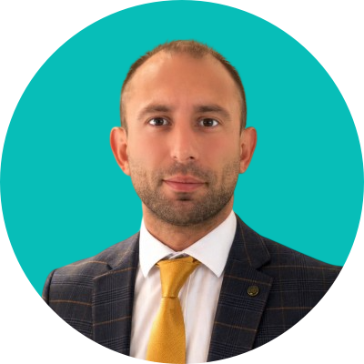


Introducing…
HOSTED BY:
THE PANELISTS:
Charlie Martin
CEO, The Anti-Greenwash Charter
Ross Dight
Technical & Sustainability Director at Tarkett
Louise Walters
Commercial Director at Designer Contracts
Tom Bourne
Creative Director at Select First
Notes:
Welcome
Name + role
Ask for hands up - in a sustainability or comms role?

Slide 3


Slide 4
Who’s in the room?
Marketing / Communications
Sustainability / ESG
Technical / Product
Leadership / Commercial

Slide 5


Slide 6
The ‘Wild West’
Rapid growth in volume
Digital & social acceleration
Few shared standards
Notes:
Last 25 years = “Wild West”
Explosion of comms (digital / social)
No shared expectations of responsible comms
Even good actors unsure where the lines are

Slide 8
A Crisis of Trust
In information
In claims
In corporate communication
Notes:
Trust in info / claims / comms
Affects all stakeholders (consumers, investors, policy)

Slide 9


Slide 10
Regulation Establishes the Baseline
Green Claims Code
DMCCA
Advertising & enforcement frameworks
Notes:
Regulation exists (Green Claims Code)
Tells you what not to do

Slide 11


Slide 13
Organisation-Wide, Public Commitment
Governance
Culture
Standards for behaviour
Notes:
This is the problem TAGC exists to solve
Independent standard - content reviews, policy development, training
Org-wide, not campaign-by-campaign

Slide 14
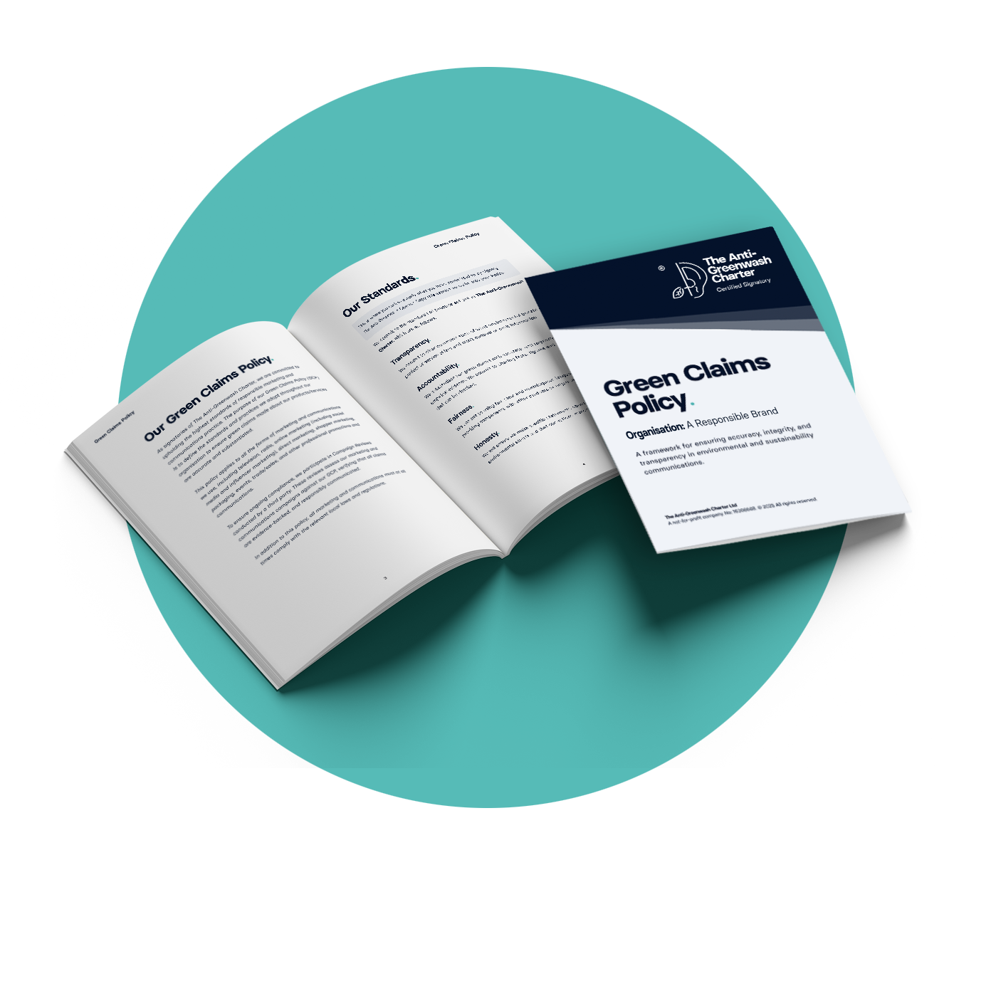
Introducing a Green Claims Policy
Green Claims Policy (GCP) Development:
Governance and oversight
Defined and standardised terminology
Evidence-based claims
International process adapted to regional contexts.

Slide 15
As a manufacturer making sustainability claims, what are the pressures and uncertainties you're navigating right now?
QUESTION LEAD:
Ross Dight
Technical & Sustainability Director at Tarkett
Notes:
Who’s responsible for responsible communication?

Slide 16
You rely on manufacturer information being correct so that projects can be delivered with confidence. What does that trust require in practice, and where does it break down?
QUESTION LEAD:
Louise Walters
Commercial Director at Designer Contracts
Notes:
Who’s responsible for responsible communication?

Slide 17
You've been through the process of developing and implementing a Green Claims Policy. What did it actually involve, and what difference has it made?
QUESTION LEAD:
Tom Bourne
Creative Director at Select First
Notes:
Who’s responsible for responsible communication?

Slide 18


Slide 19


Slide 20

Download Our Template
At: antigreenwashcharter.org/green-claims-policy-template/
antigreenwashcharter.org

