Slide 1
Communication:
The Superpower for
Culture Change
Jennifer Sproul
Chief Executive

Slide 2

IC Index 2026
The gap between knowing and doing
5,000 UK employees. 2026. Every sector. Including yours.
50%
trust their senior leaders
58%
do not agree their organisation is good at helping employees adapt to change
Four-year low — the foundation of every change programme.
Sustainability is a change programme. This is the baseline.
52%
feel valued by their organisation
49%
agree the reasons behind changes are clearly communicated
Advocacy is hard to build from a base of disconnection.
Down 7 points. Less than half. And this is change communication generally.
Notes:
SLIDE 2 — THE GAP (2 mins)
This is the IC Index 2026 — 5,000 UK employees, surveyed this year. These four numbers tell you everything you need to know about the communication challenge sitting underneath your sustainability agenda.
50% trust their senior leaders. Four-year low. That is the foundation you are building on. You cannot ask people to genuinely change how they work and what they believe if half of them don't trust the people asking.
58% say their organisation is not good at helping employees adapt to change. That is the majority. And sustainability is, at its core, a change programme. If your organisation is already failing at change communication generally, you are carrying that deficit into your sustainability work.
52% feel valued. Just over half. The connection between feeling valued and being willing to go beyond compliance — to genuinely advocate for something your organisation believes in — is direct. You need that advocacy for sustainability to move from target to culture.
49% feel reasons behind change are clearly communicated. Down 7 points. Less than half. Ask yourself: where does your sustainability communication sit against that benchmark?

Slide 3
Trust is declining
73%
Trust in manager
50%
Trust in leadership team
50%
Trust in CEO
Notes:
SLIDE 3 — TRUST (2.5 mins)
Trust in senior leaders has fallen to 50%. That is a four-year low.
But notice the top figure: 73% trust their manager. That gap between trust in the immediate manager versus trust in senior leadership is the most important number in this slide — and I'll come back to it.
The right side shows the gap data. 87% of senior leaders believe the strategy has been clearly communicated. 57% of employees agree. 80% of leaders believe the strategy is right. 44% of employees agree — less than half.
On AI, 67% of leaders believe they have clearly explained what is happening. 27% of employees agree. A 40-point gap.
Ask yourself: where do those gaps exist in your organisation on sustainability? Leaders tend to believe the message is landing. It usually isn't — not fully, not at depth. That gap is a cultural and communication failure, and it accumulates into disengagement.
Trust is the second reality check. And what strikes me here is that this is not a story of trust falling everywhere equally. It is much more specific than that. Trust in direct managers remains materially stronger. But trust in senior leadership and CEOs has dropped sharply, with only half of employees saying they trust those at the top.
That matters because trust is not a soft measure sitting off to the side of performance. It shapes whether difficult conversations are believed, whether change is accepted, and whether people feel confident in the direction the organisation is taking. When trust weakens, those things get harder.
And we should pay attention to where the decline is concentrated. Because the fact trust in managers is holding up much better suggests this is not a general breakdown in relationships at work. It points to something more specific about confidence in senior leadership. In whether leaders feel credible, connected and in touch with the realities employees are experiencing.
And I think that creates a challenge for communicators. Because visibility on its own will not fix that. Trust is not rebuilt simply by leaders being seen more often. It is rebuilt when people believe leaders understand what is happening in their world, are honest about difficult realities, and communicate with candour rather than polish.

Slide 4
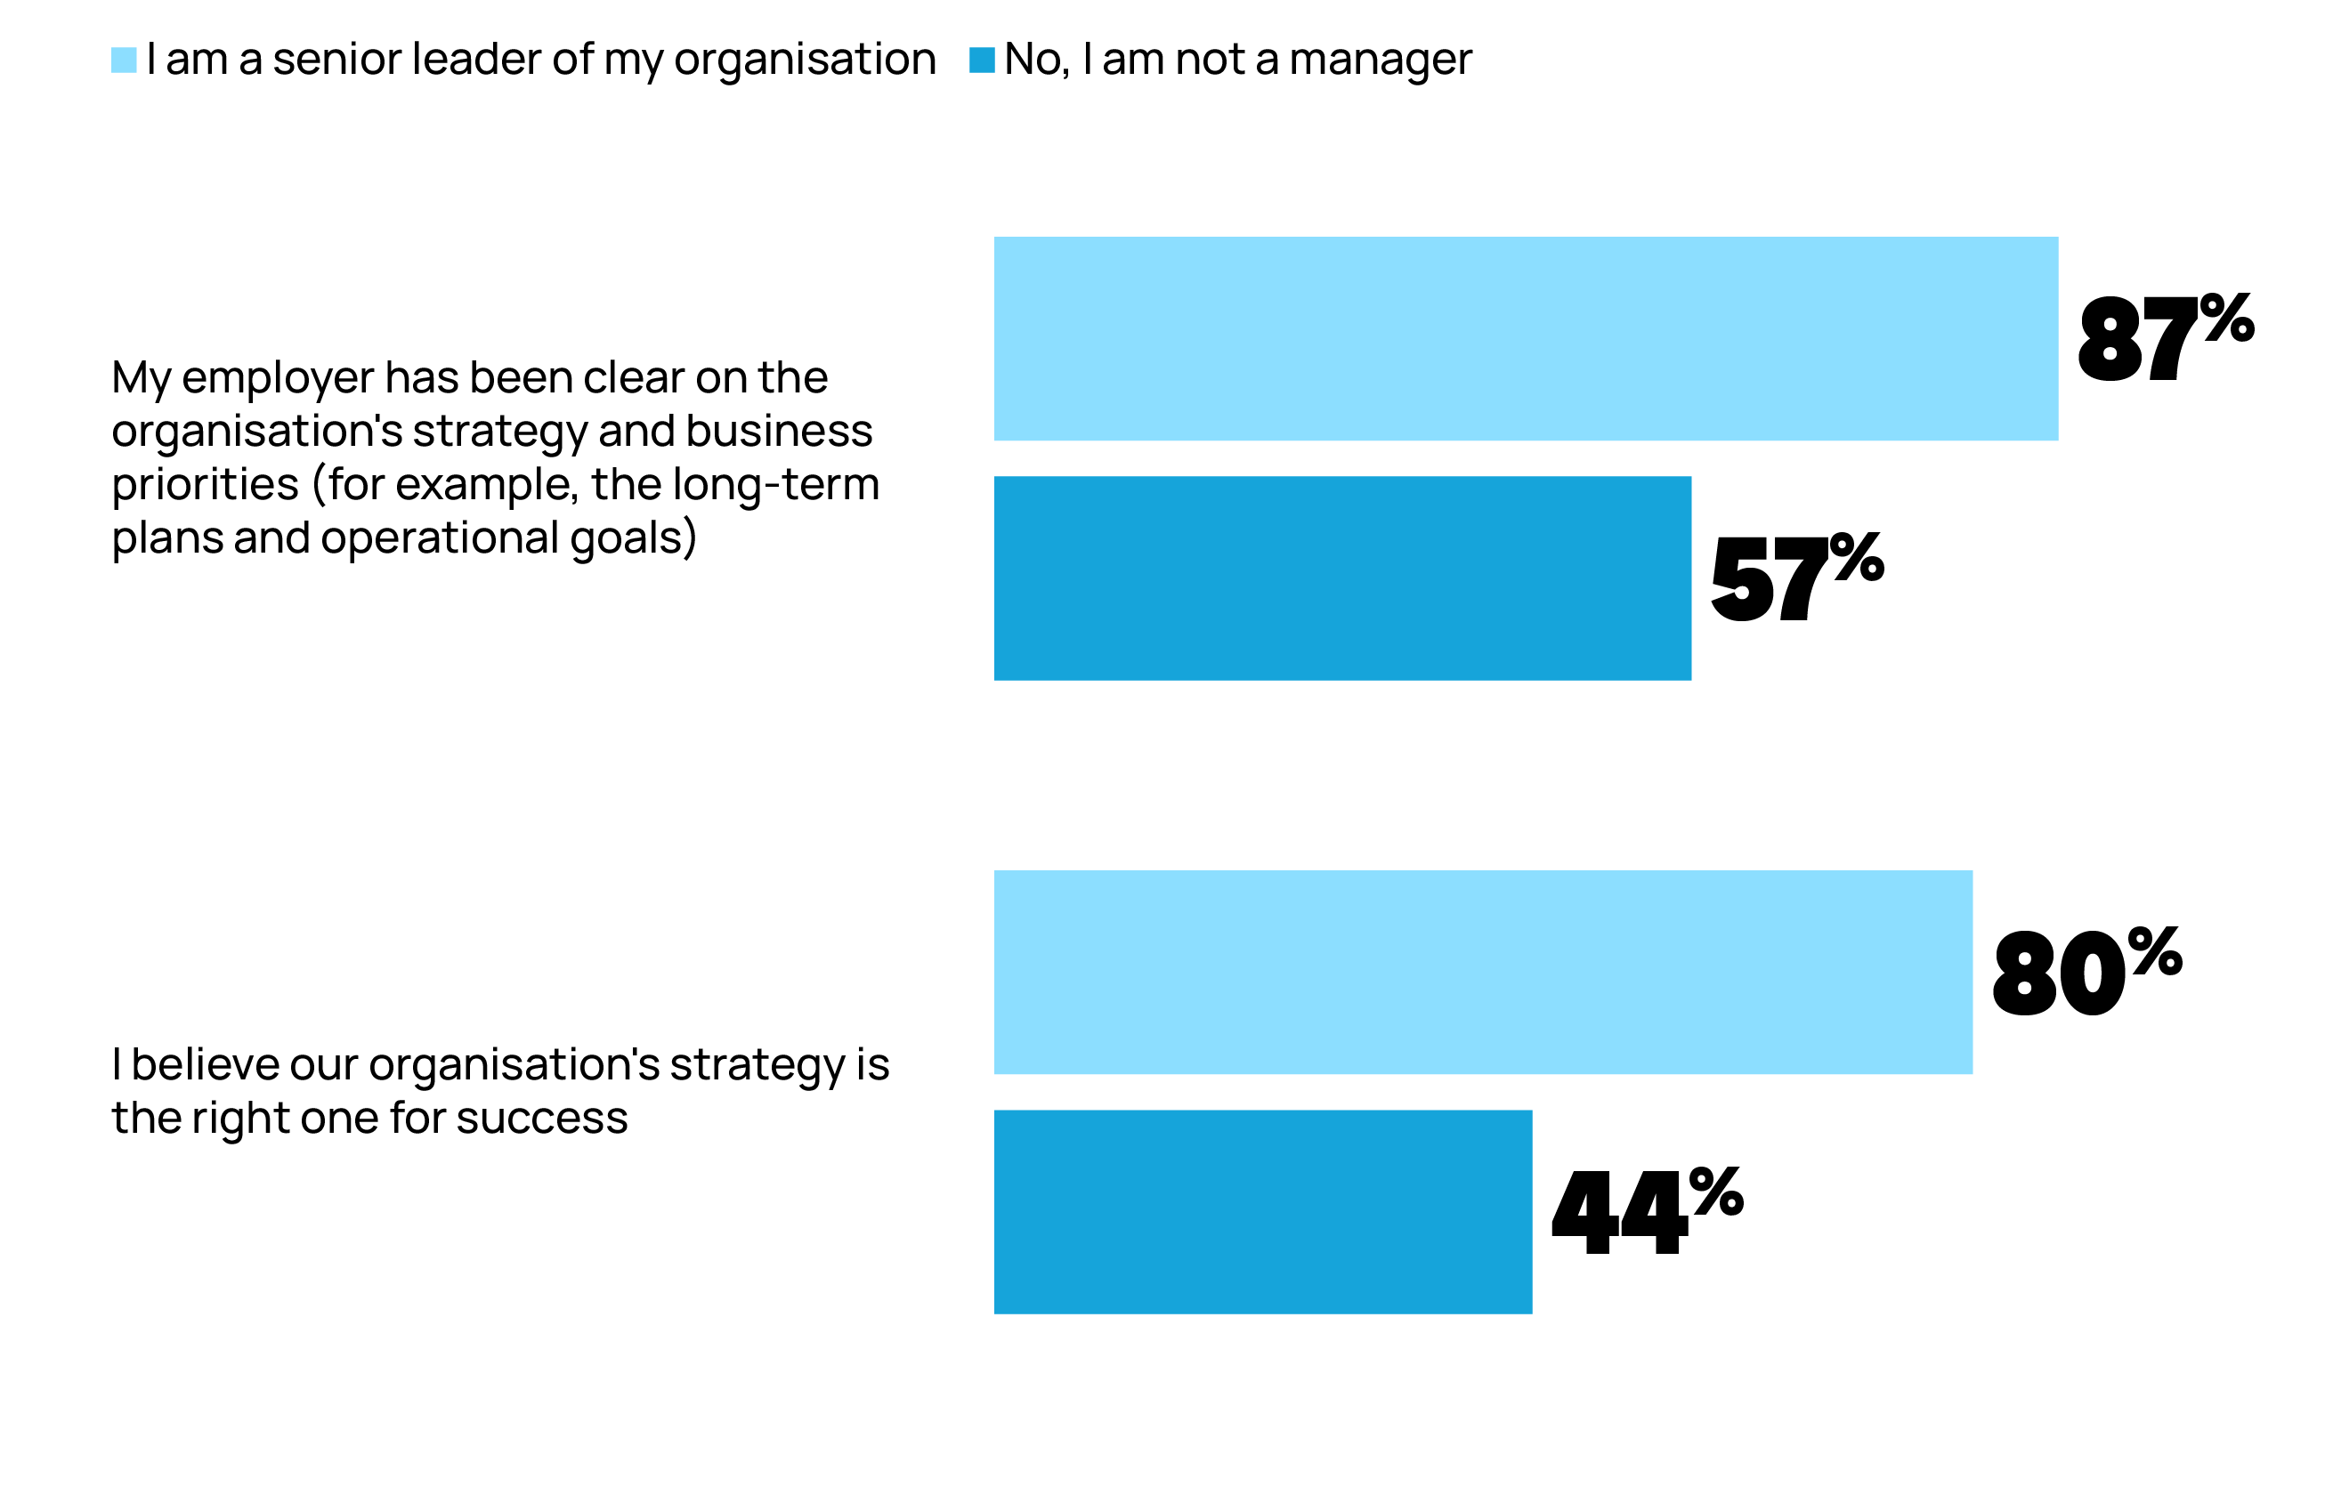
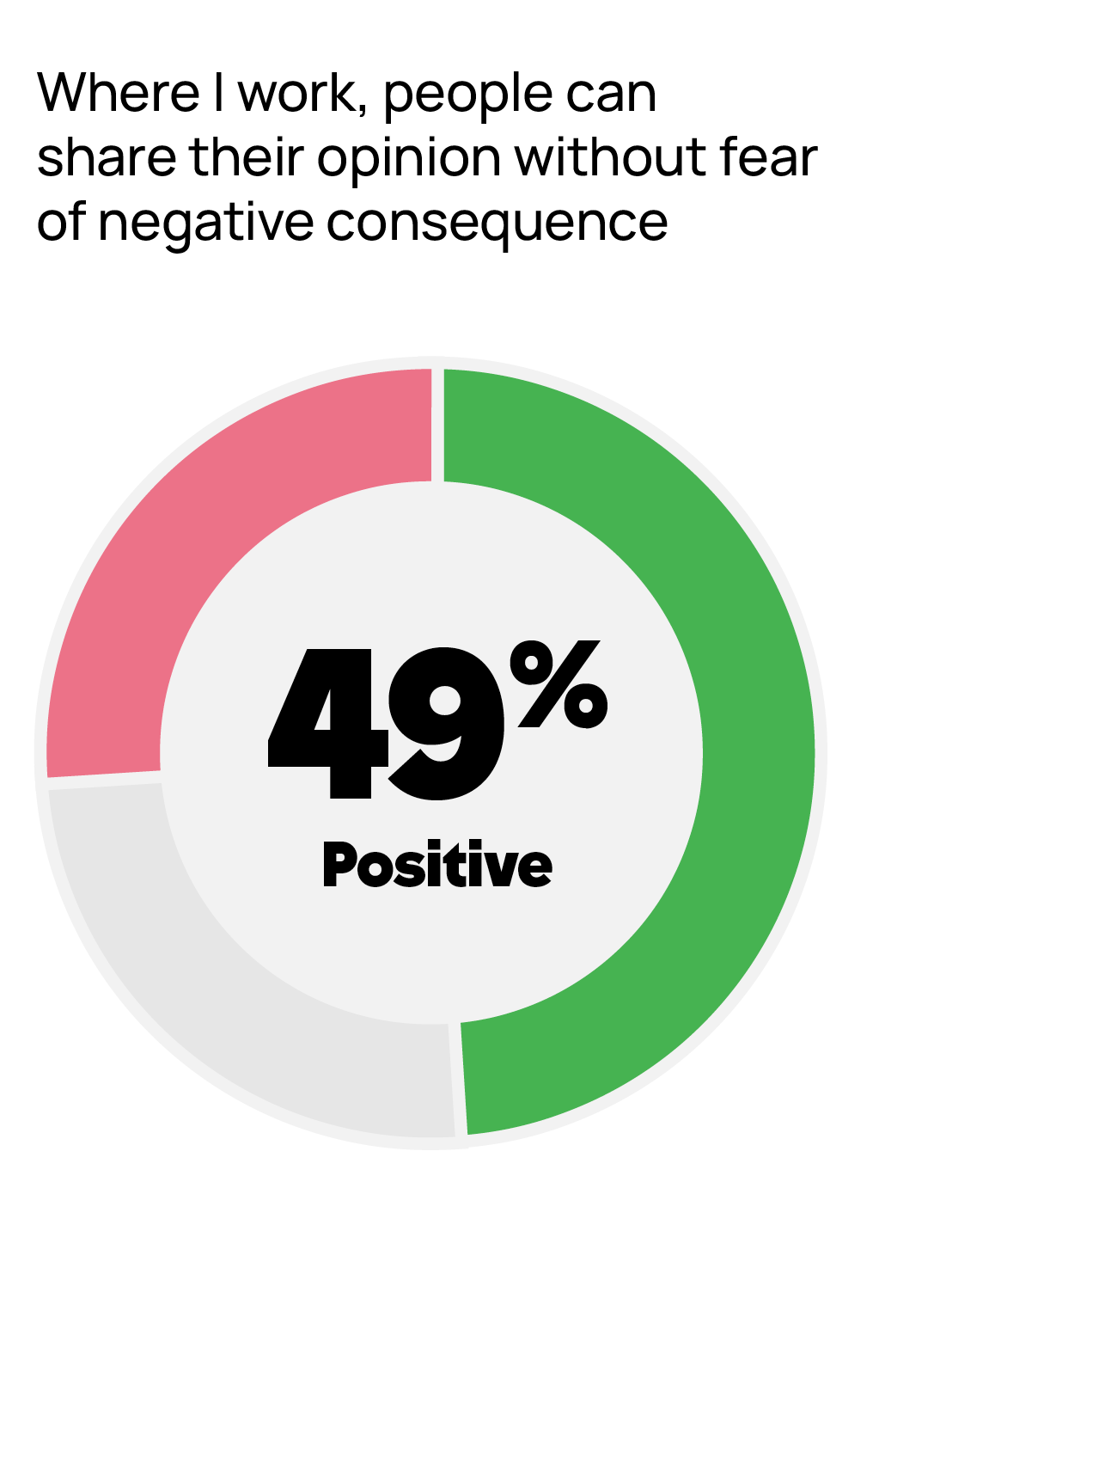
Many leaders are out of touch with employees’ perspectives…
...And psychological safety is low

Slide 5
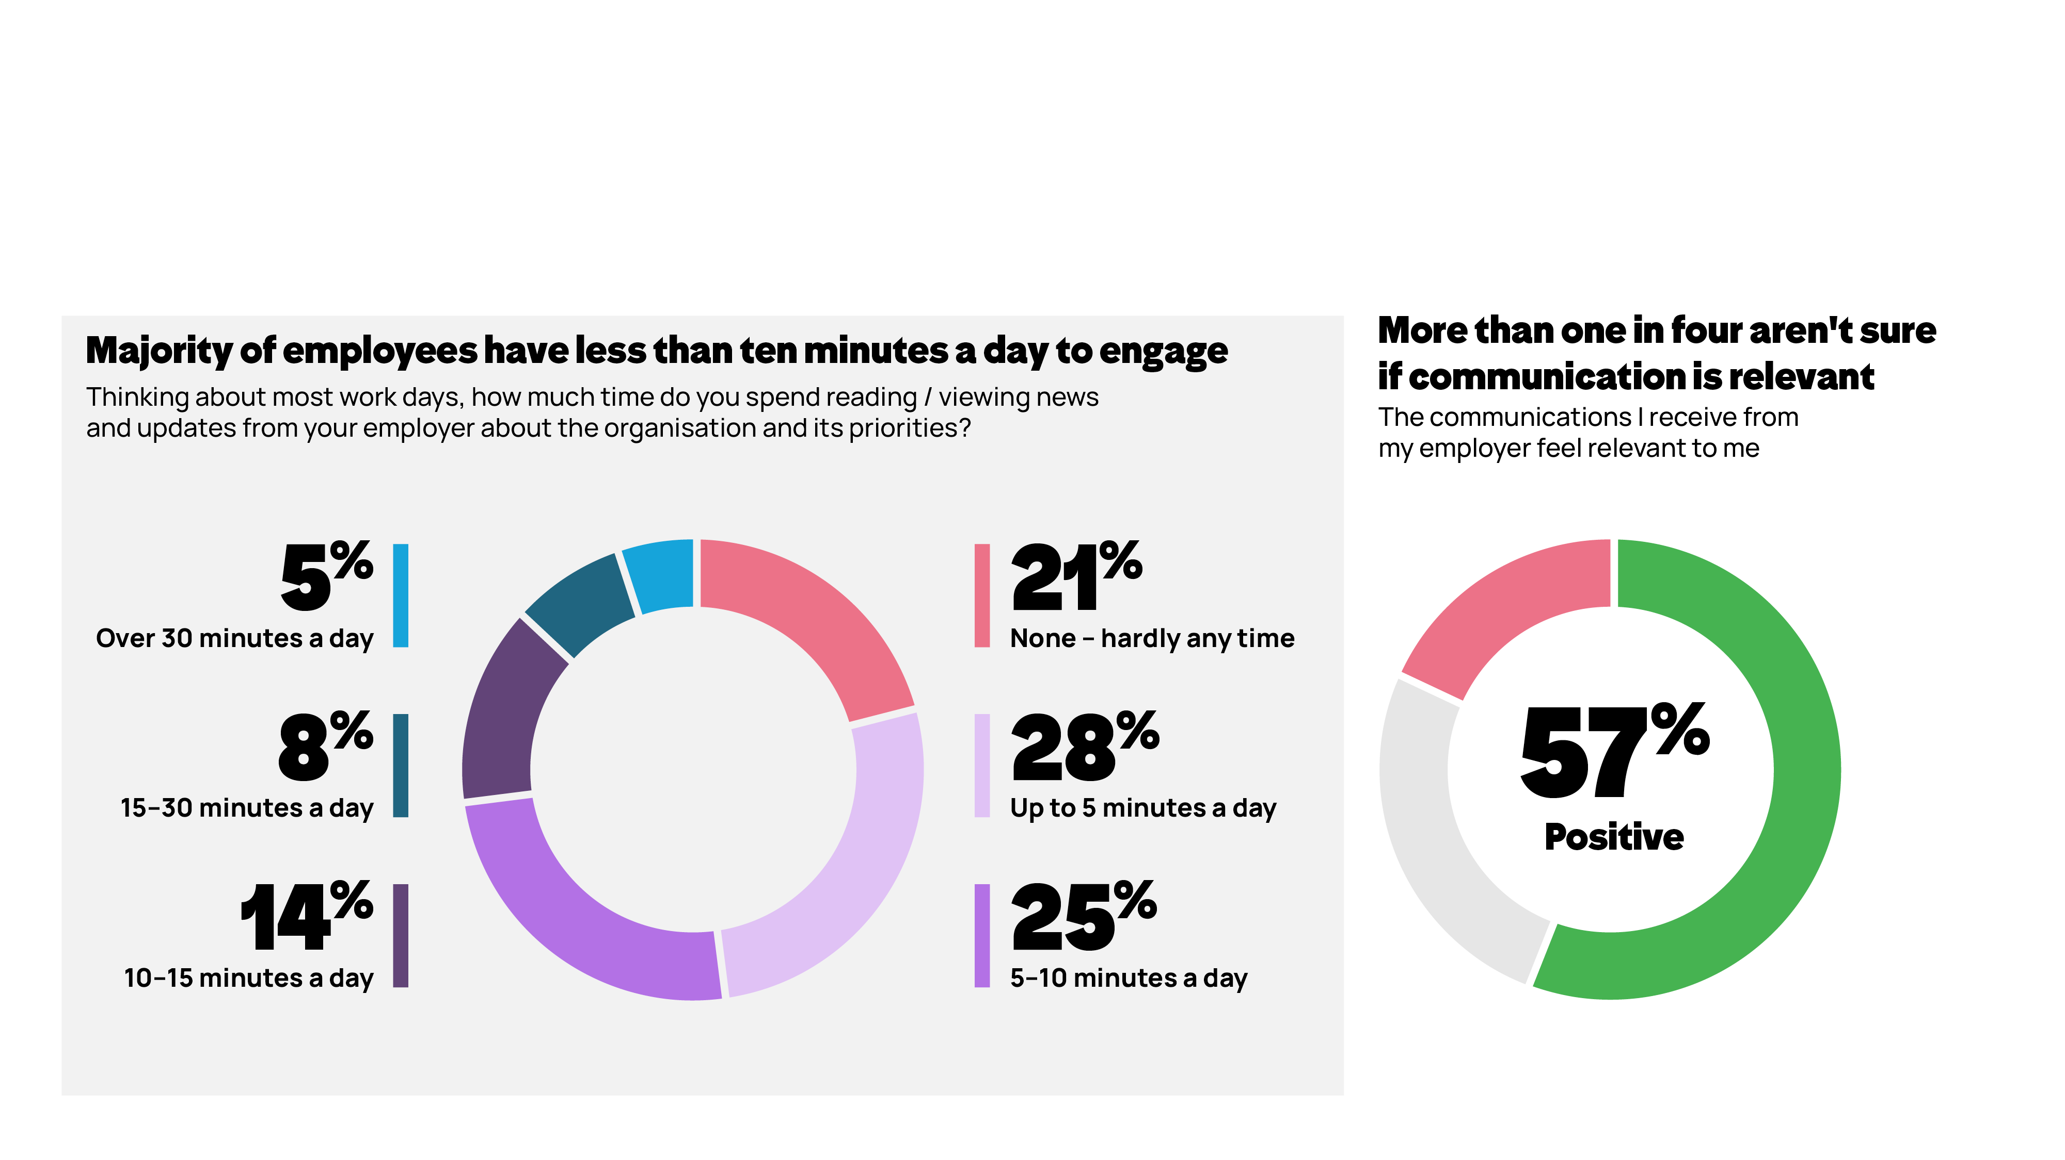
Employees have less time and every touchpoint has to count
Notes:
The fifth reality is time. And I think this is one many communicators will recognise intuitively, but the scale of it is still striking.
Most employees have ten minutes or less a day to engage with organisational communications. One in five say they have hardly any time at all. That means attention is not just limited. For many people, it is genuinely scarce. And that changes the standard communication has to meet. Because in that context, the question is not simply how much we communicate. It is whether we are making the most of the moments of attention we do get.
And I think we can be honest that too often the instinct is to respond to complexity with more. More messages. More channels. More content. More noise. But if people have limited attention, maybe the discipline is not volume. Maybe it is prioritisation. Being clearer about what matters most. Being more relevant. And focusing communication on what helps people do their jobs better.
I also think there is an important nuance in what we found. It is easy to assume that when time is short, only operationally critical messages matter. But we also found poor communication of good news can damage advocacy more than mishandling bad news. That is a useful reminder that relevance is not just about utility. It is also about helping people feel connected, informed and positive about where they work.
This is not just a story about people having less time. It is a challenge to be much more deliberate about how we use the time we do get.

Slide 6
How communication drives culture change
So, what does communication need to do? Move people through three stages:
Think
Feel
Do
Understand
Believe & connect
Act & sustain
People trust that the commitment is genuine. They feel it aligns with what the organisation stands for. They feel their contribution matters and that they are part of something real.
People change their behaviour, make different decisions, and advocate for the agenda. They feel equipped and empowered — not just instructed.
People know why sustainability matters, what the organisation is committed to, and what it means for their role. Clarity creates the foundation for everything else.
Can people explain why it matters — and what their part is?
Do people believe the goals are genuine — and feel personally connected to them?
Do people feel equipped and empowered to act?
Notes:
SLIDE 4 — THINK, FEEL, DO (2.5 mins)
This is the framework that underpins everything else I'm going to say.
Communication is not the same as information. Sending an email is not communicating. Publishing a sustainability report is not communicating. Putting targets on a website is not communicating.
Communication — real communication — moves people through three stages.
THINK: Do they understand? Not just that you have a sustainability target, but why it matters, what you're doing about it, and what their role in it is. Most organisations have a knowledge gap here that they underestimate significantly.
FEEL: Do they believe it? Do they trust that the commitment is genuine? Do they feel connected to it personally — that their contribution matters? This is where the trust data hits hardest. You cannot build genuine commitment through channels that people don't trust.
DO: Are they changing behaviour? Are they making different decisions? Do they feel equipped to act — not just told to? And here is the key: are they advocating for it? Employees who genuinely own a sustainability agenda tell their colleagues, their customers, their communities.
Most sustainability communication focuses entirely on THINK. It rarely reaches FEEL. And without FEEL, DO doesn't follow.

Slide 7
What internal communication actually does
Connects vision to action
Builds the trust that makes change possible
Translates leadership intent into something employees understand and can act on. Without this, sustainability strategy stays at the top.
You cannot skip the groundwork: trust is earned through consistent, honest communication, especially in difficult moments.
Reaches the audiences others miss
Creates the feedback loop organisations
need
Frontline workers, remote staff and supply chain partners are often closest to the product and the waste. Reaching them is sustainability communication that works.
Listening is as important as telling. A communication ecosystem that hears as well as speaks turns insight into action.
Notes:
SLIDE 5 — WHAT IC ACTUALLY DOES (2 mins)
So what does internal communication actually do? It is not the newsletter or the all-hands meeting — those are tools. It is the strategic discipline that connects what an organisation is trying to achieve to the people doing the work.
CONNECTS: Your CEO can have a brilliant sustainability strategy. If the warehouse team don't understand how it changes what they do on Tuesday morning, it will stall.
TRUST: With only 50% trusting senior leaders, you cannot assume messages land. Trust is the container that communication travels through. If the container is cracked, the message leaks.
REACHES: The people with the most direct impact on your sustainability performance are often the least served by corporate communication. Frontline workers, those without computer access. Slide 9 from the IC Index showed 35% of frontline workers trust their CEO versus 54% of desk workers — a 19-point gap. That is your biggest sustainability communication risk.
FEEDBACK LOOP: Only 49% feel psychologically safe enough to share opinions without fear. In most organisations, the feedback loop is either not trusted or not used. You are making decisions without the intelligence you need.

Slide 8

Managers are your most trusted communication channel
73%
The opportunity
When managers make communication relevant and local, advocacy increases, relevance rises and connection to purpose strengthens.
The challenge
of employees
trust their manager
Too much adaptation and the message gets lost. Too little and it feels like corporate broadcast. The balance requires manager enablement, not just instruction.
vs 50% for
senior leaders
What this means
Give managers the sustainability narrative before launch. Equip them with the three questions they will be asked, then brief them as advocates.
Notes:
SLIDE 6 — MANAGERS (2 mins)
73% of employees trust their manager. Only 50% trust senior leaders. That 23-point gap is the most important number for anyone trying to drive culture change.
Managers are the last mile of communication in every organisation. They are also the most trusted voice. Yet they are chronically under-supported.
The IC Index data shows a clear pattern: when managers adapt communication — when they take the central message and make it real for their team — advocacy increases, relevance shoots up, connection to purpose strengthens. Not marginally. Significantly.
For sustainability, this is decisive. Your managers are the people having daily conversations with those closest to your waste, your materials, your process decisions. If they don't have a clear, confident, honest answer to 'why does this matter and what are we actually doing about it', your strategy stops at the manager layer and never reaches the people who can act on it.
The investment is low. A short briefing. The three questions they'll be asked and the answers. A conversation, not an email chain.

Slide 9
Listening is the superpower
inside the superpower
What genuine listening looks like
The problem
A visible cycle: ask, protect, act and invite people into the solution.
say colleague feedback visibly informs decisions and actions
1
Ask, don't assume
44%
Short, frequent pulse questions — not annual surveys. Are people understanding the why? Do they believe it?
2
Create safe channels
Build the conditions for people to speak. Only 39% of frontline workers feel safe. Start there.
3
Close the loop visibly
"You told us X, so we did Y." That signal — that speaking up makes a difference — is worth more than any communication campaign.
4
Invite people into solving it
From communication that tells, to communication that invites. People who help solve a challenge own the solution.
Notes:
SLIDE 7 — LISTENING / PSYCHOLOGICAL SAFETY (2.5 mins)
Only 49% of employees feel safe sharing opinions without fear of negative consequence. That is a number that should stop any leader in their tracks.
And for frontline workers — the people closest to your sustainability operations — it is 39%. Less than four in ten. Against 52% for desk workers. That 13-point gap means the people you most need to hear from are the least likely to speak up.
Most sustainability communication is one-directional. Organisations announce targets, publish reports, send updates. They rarely ask: does this make sense to you? What would you change if you could? What are we missing?
The employees closest to your materials, your waste, your processes often know things that leadership doesn't. Without genuine listening infrastructure, that knowledge is invisible.
Four things that genuine listening looks like:
- Short, frequent pulse questions — not once a year
- Channels that frontline workers can actually use
- Closing the loop explicitly so people see the point of speaking up
- Inviting people into solving challenges, not just informing them about them
The organisations making real progress on sustainability have one thing in common. They listen as well as tell. And their people feel it.

Slide 10

Five principles for
communicating culture change
Culture change lands when people understand the why, see themselves in the story and have a way to act.
1
Lead with meaning, not messaging
4
Build listening infrastructure
Connect the change to purpose and values — the why before the what.
Ask, hear, act and close the loop so people can see their voice shaping decisions.
2
Make it human
Use colleague stories, local impact and practical examples. Avoid corporate abstraction.
5
Measure resonance, not just reach
Track whether people understand, believe and feel able to act — not only whether the email went out.
3
Equip your managers
Give managers the narrative, FAQs and confidence to hold real conversations.
Bottom line: communicate with people, not at them.
Notes:
SLIDE 9 — FIVE PRINCIPLES (2.5 mins)
01 MEANING: The difference between 'we are targeting a 30% reduction in carpet waste by 2028' and 'last year our industry sent X tonnes to landfill. Here is what we are doing about it and here is your part in it.' One is a metric. One is a story.
02 HUMAN: Find the person in your organisation for whom the sustainability agenda became real. The installer who got asked by a customer what happens to the offcuts. The warehouse team who saw the scale of offcuts with their own eyes. That story is worth more than any policy document.
03 MANAGERS: Back to the 73%. Give them a short brief. The three questions they will be asked. A 20-minute briefing conversation. The return on that investment is enormous.
04 LISTENING: Don't just tell people what you're doing — invite them to help shape what comes next. That shift from broadcast to dialogue is what builds genuine culture, not compliance.
05 MEASURE: Ask your people what they understand, whether they believe it, whether they feel equipped to act. Survey it. Ask managers. Build the feedback loops. The data will tell you what to fix.

Slide 11
The technology will change.
The standards will evolve.
But the organisations that make sustainability real
will be the ones that bring their people with them.
That is what communication does.
Notes:
SLIDE 10 — CLOSE (30 secs then Q&A)
'You are working in a sector trying to do something genuinely hard and important. The technology, the standards, the legislation — they will keep evolving. But the organisations that make this real — that build it into their culture, into the decisions people make every day, into what people feel proud of — they will be the ones that communicate their way there.
That is the superpower. And it belongs to every leader, every manager, and every communicator in this room.'
Q&A PREP:
- Small business with no comms function? → Managers first. A simple one-page brief. One honest team conversation. One story collected from the floor.
- Dealing with scepticism about sustainability claims? → Transparency is the only answer. Acknowledge what you haven't yet achieved. Scepticism is a response to spin — honesty disarms it.
- How do you measure culture change? → Understanding (do people know the agenda?), belief (do they think it's genuine?), confidence to act. Short pulse surveys. Manager feedback. Don't wait for annual.
- What if leadership isn't bought in to communication investment? → Show them the gap. 87% of leaders believe strategy is clearly communicated. 57% of employees agree. Ask which number they want to be true for their sustainability agenda. That usually opens the conversation.

