Slide 1
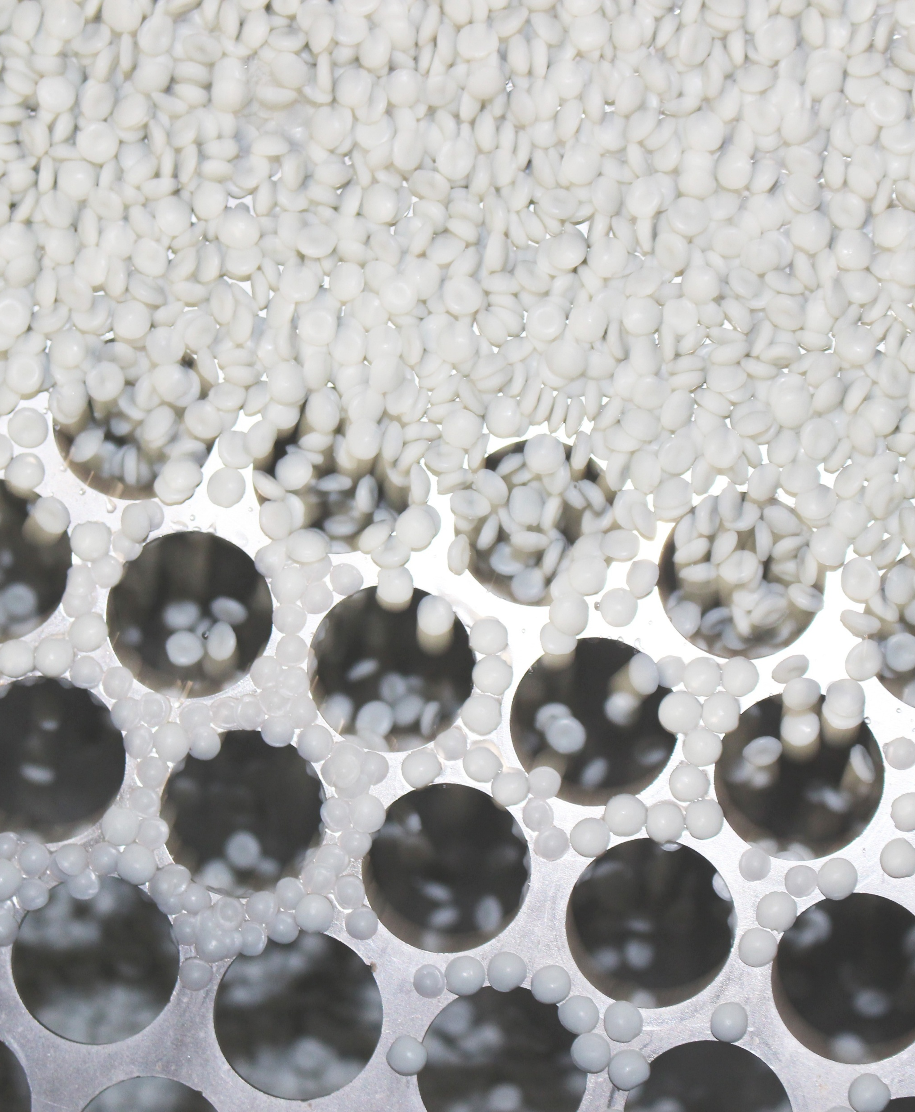
Elevating Flooring Waste: Strategies for Reuse and High Value Recovery
Chris Griffin
Head of Commercial Development

Slide 2
Circularity Starts at Source
It’s not a technology problem
It is a material quality & availability problem:
              Recycling lives or dies on input quality
              Input costs correcting for mixed & dirty waste reduces incentives
              Lack of visible and committable feedstock hinders investment
Contamination destroys value faster than any other factor

Slide 3
Where it Goes & Why it Matters
400kmt to 500kmt is produced annually in the UK
        Mixed fibres, backings, adhesives
        Hard to quantify if coded as Bulky Household Waste
Historically: landfill, EfW, some equine surfaces
        Risks: Landfill tax increases, ETS, POPs
High carbon intensity | High embedded material value | Low recovery under current system
Material State | Outcome | Value
Segregated & clean | Closed-loop recycling | HIGH
Partially mixed | Downcycling | MEDIUM
Fully mixed & dirty | Energy recovery/landfill | LOW

Slide 4
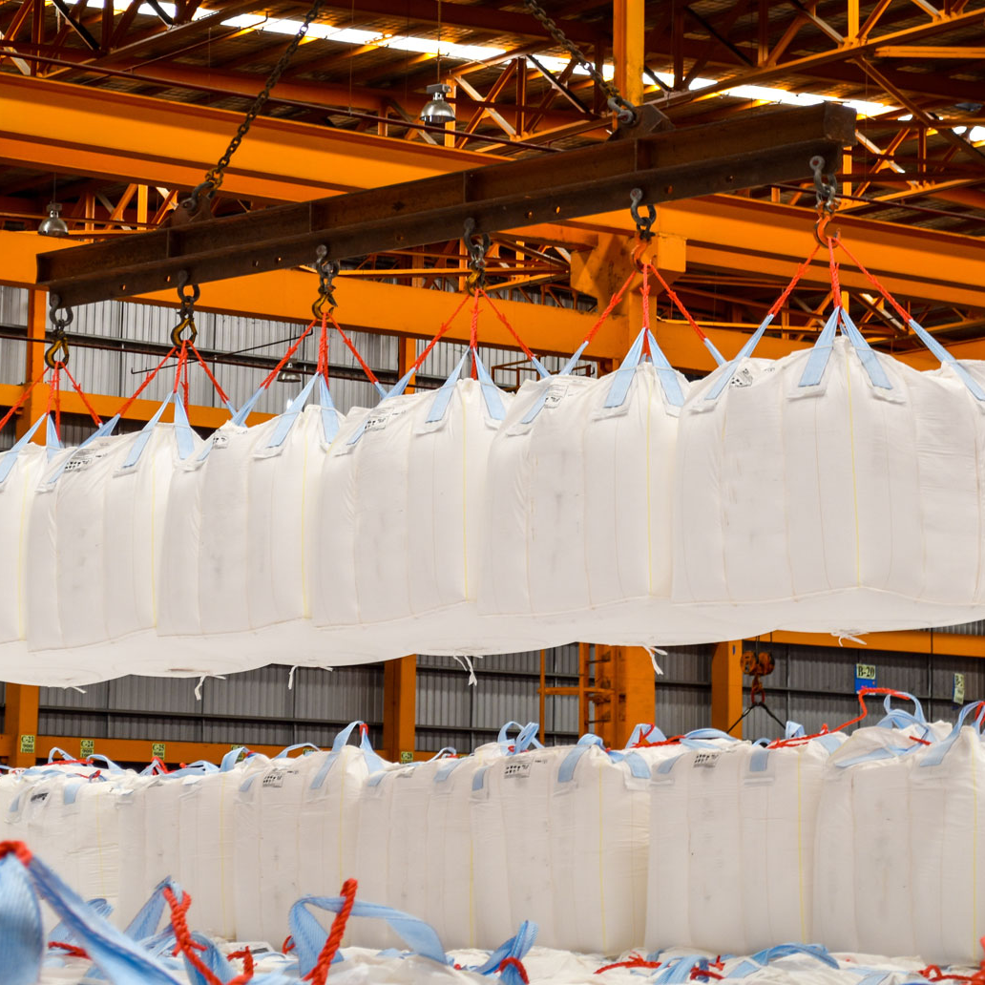
Source Segregation: The Critical Control Point
First and most important step in waste management
Enables reuse, recycling and recovery pathways
Prevents irreversible contamination
It costs to recover quality once materials are mixed

Slide 5
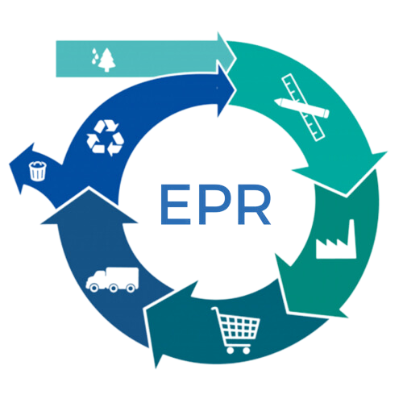


Shifting Landscapes
Legislation & Taxation driving change

Slide 6
Industry Leaders
The technology exists and is ready to scale
Operators are building the value chain
              Reuse and recycling options exist and are being invested in
              The loop is starting to close back to remanufacture
      Source Segregation is critical to cost control and access to material
              Recyclate can only be valorised above virgin polymers where input costs are minimised
              Reprocessors can only invest in capacity where feedstock is available

Slide 7
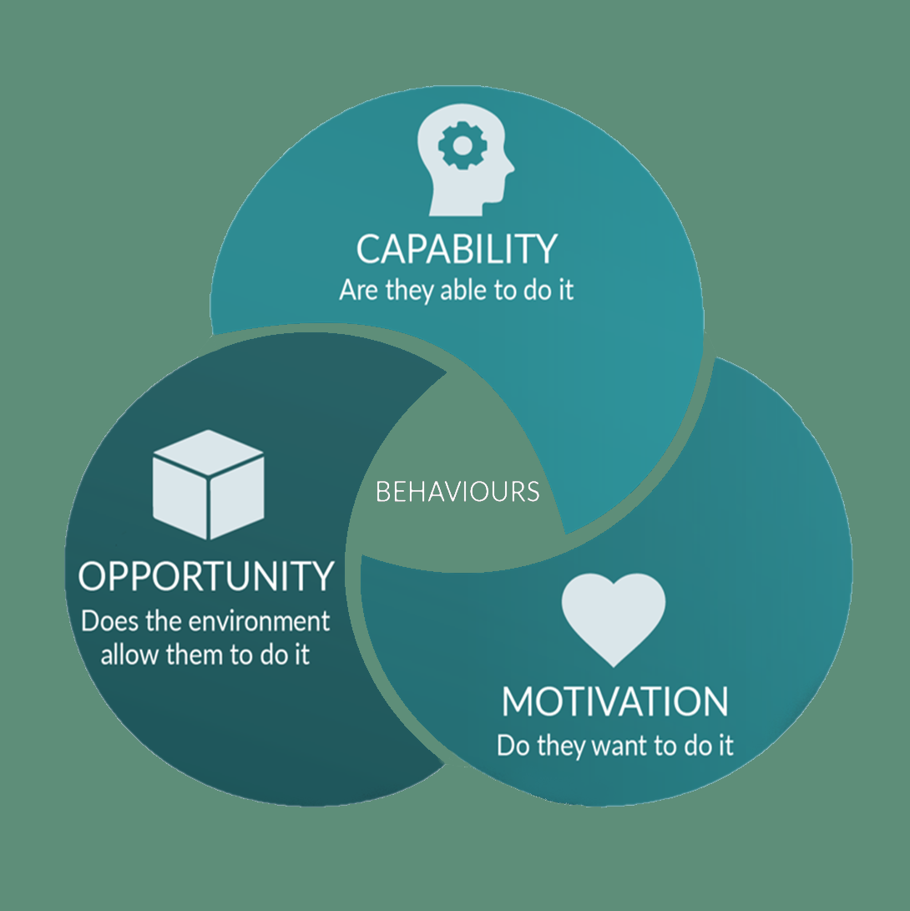
Source Segregation: The Critical Control Point
The technology exists and is ready to scale
      Circularity succeeds when systems start upstream
              Systemic changes start with behaviour
              Manufacturers need drop-in equivalent material for business continuity & product quality

Slide 8
Take-Back Schemes: System Control
Advanced tech fails without upstream segregation
Capital can’t linger indefinitely
        Use it or lose it
Take-back schemes are at the heart of the solution
        Controls the collection pathway
        Incentivises correct behaviour
        Builds reliability and consistency
        Reduces contamination and improve feedstock purity
        Preserves material quality at source
        Creates guaranteed feedstock for reprocessors
Allows the Value Stream to Adjust

Slide 9
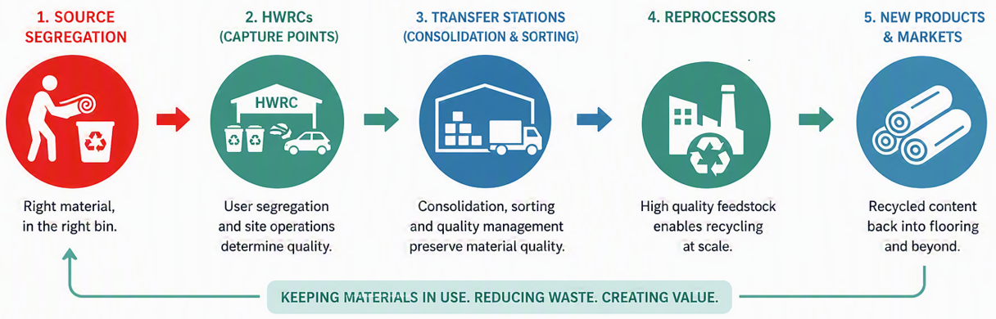
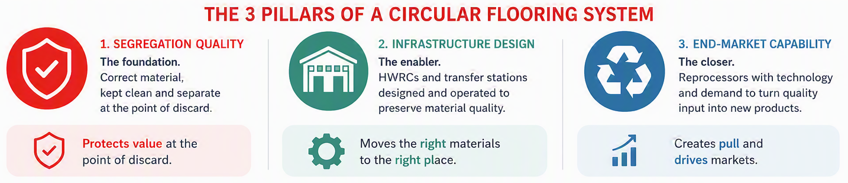
The Circular Loop

Slide 10

Questions

Slide 11
Thank You
Chris Griffin
Head of Commercial Collections

