Slide 1

Specifics:
What to do now?
Su Butcher

Slide 2
What to do now?
01 Digital Product Passports
02 How to prepare
03 What’s coming to help

Slide 3
Digital Product Passports:
Find out more
01

Slide 4
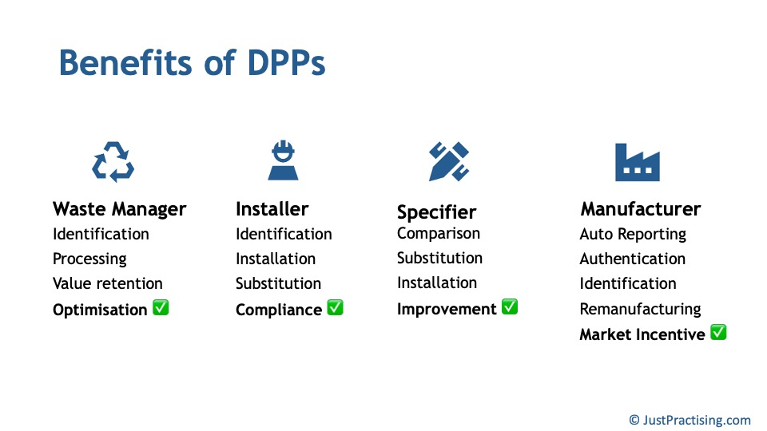
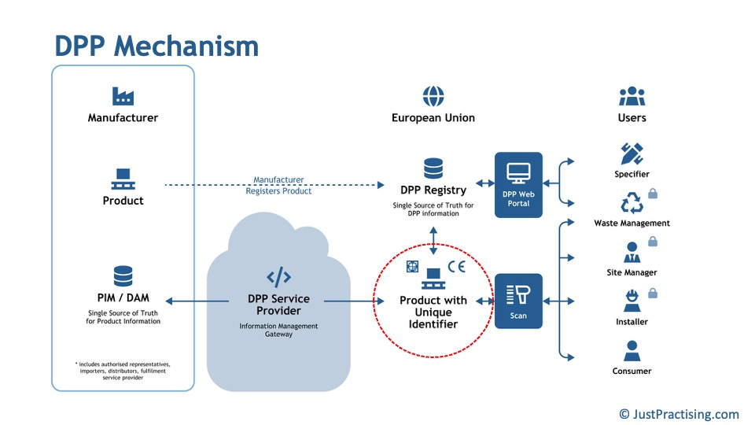

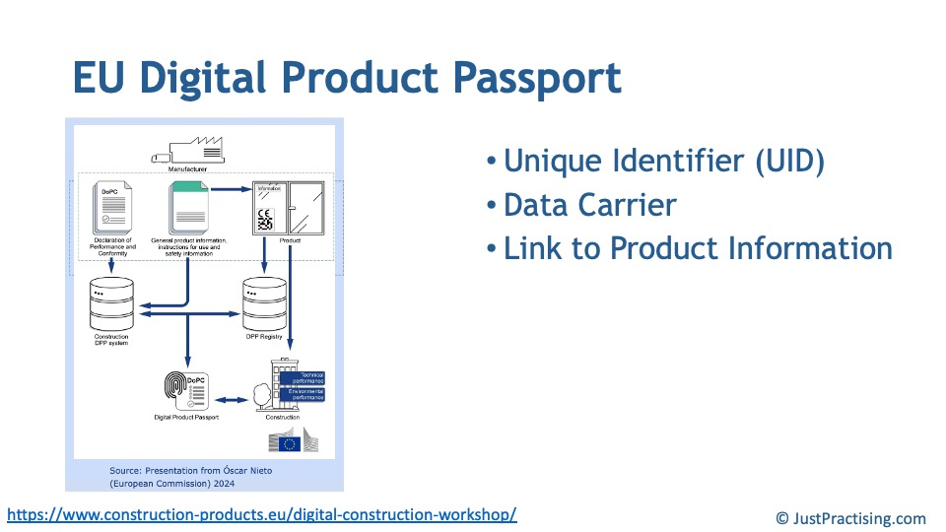
Introduction to DPPs
5th November 2025 – UKSFA Wednesday Webinar

Slide 5
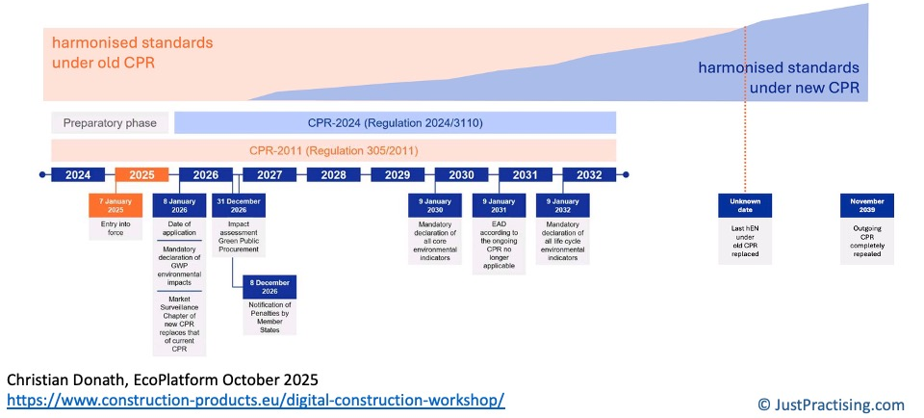
20-year process
5th November 2025 – UKSFA Wednesday Webinar

Slide 6
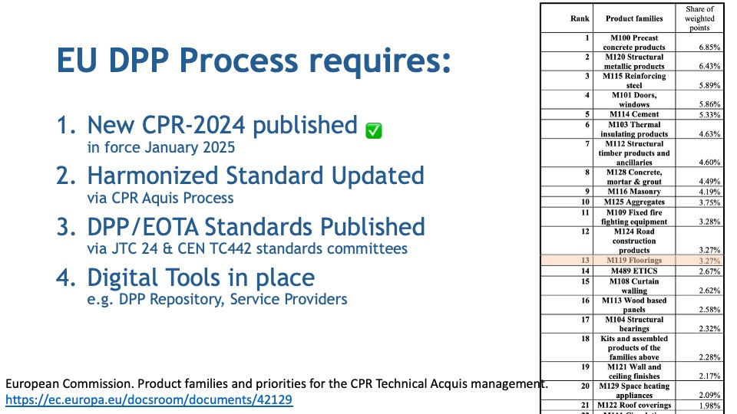

Slide 7
How to Prepare for Digital Product Information Sharing
02

Slide 8
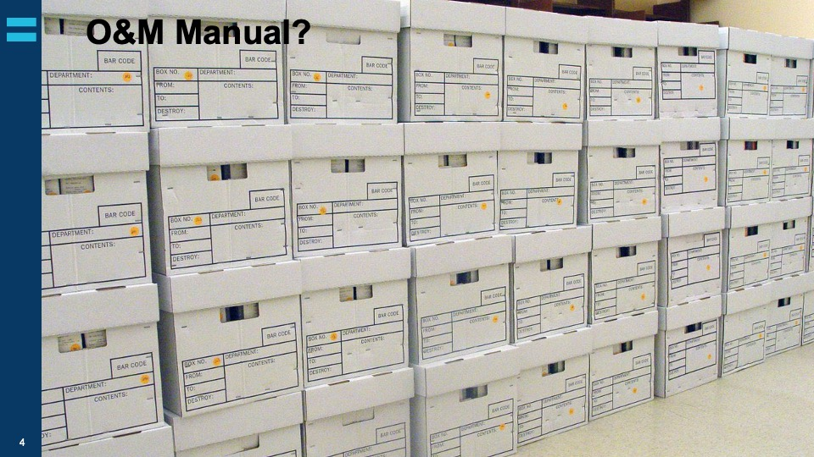

Slide 9
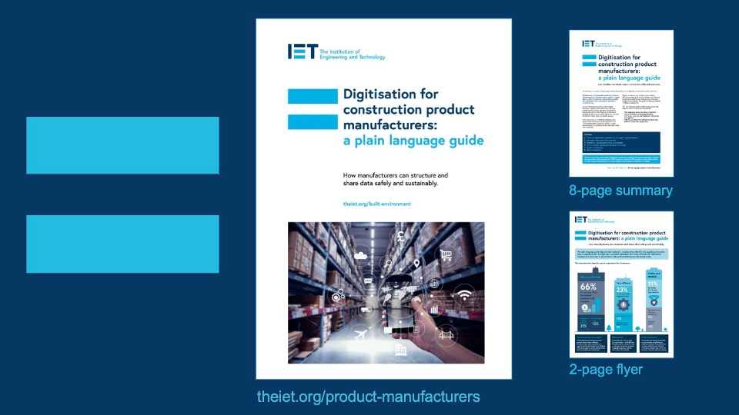

Slide 10
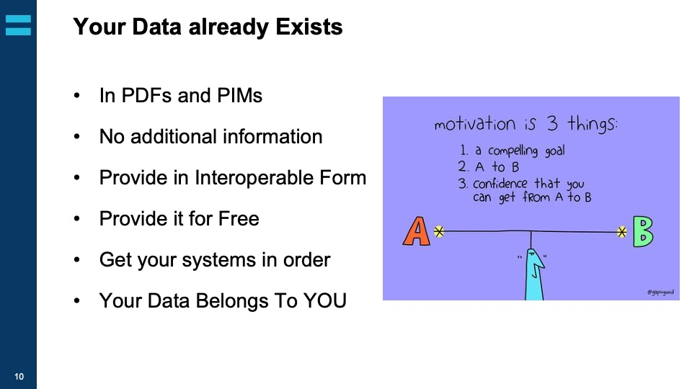

Slide 11
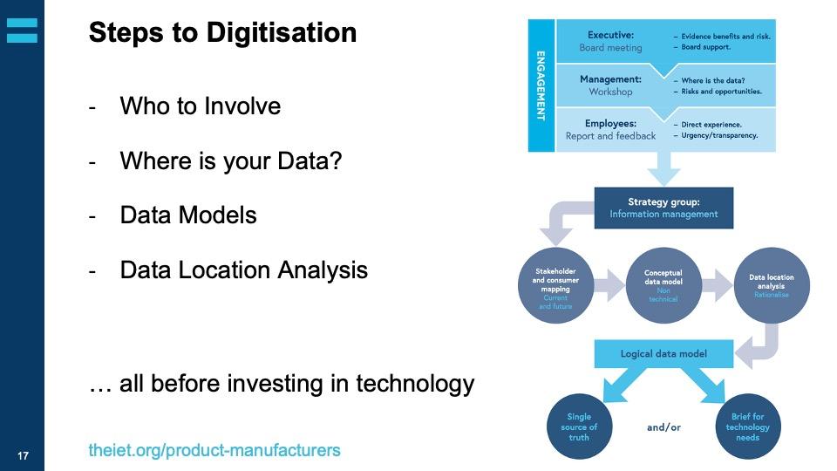

Slide 12
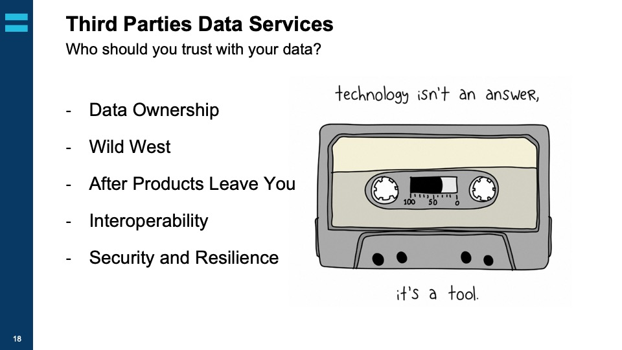

Slide 13

What’s Coming Next that could help?
03

Slide 14


The information challenge
    Digital transformation
    requires manufacturers’ product information.
    Sharing product information is complex, costly, and insecure.
    Industry needs a joined up, collaborative approach.

Slide 15
Construction product manufacturing in Europe
The information challenge
430K
Manufacturers
in Europe
50%
Employ fewer
than 10 people

Slide 16
Simplifying access to construction product information across Europe
What is The MIH?

Slide 17


Inspiration from the travel sector
The information challenge
Information providers
Global Distribution System (GDS)
Information users
Two-way interfaces – full interoperability
Individual systems
Individual systems
Implemented rules and standards
Common platform

Slide 18
How it will work
What is The MIH?
Manufacturer’s information
Information users
PIM Systems
Specifiers
The Manufacturers’ Information Hub
Regulators
MINI PIM
Systems
Contractors
Building
logbooks
Third party
PIM systems
EPD
Repository
DPP
Repository
Data
Dictionaries
Asset
management
systems

Slide 19

The Manufacturers’ Information Hub is not a database
What is The MIH?
          The MIH facilitates information exchange between systems, it does not replace them
          The MIH works alongside existing
          PIM and IT systems
          Manufacturers remain in
          control of their own data
          The MIH provides a shared trusted integration layer

Slide 20
Who we are
What is The MIH?
Ownership, governance and structure
          Not for profit
          Manufacturer owned
          One member,
          one vote
          Centralised IP ownership
The MIH (Europe) AISBL
Manufacturers involved
7-Steel ArcelorMittal ASSA Abloy Bekaert BASF Chems Dormakaba Etex Falk Heidelberg Holcim Knauf | Kingspan Rockwool Saint-Gobain Siderise SIG Sika StoraEnso Tata Steel UK Velux Wienerberger
Board of Directors
Exec. Steering Committee
Plus
Construction Products Europe Construction Products Norway DI Byggeri (Denmark) NVTB (Netherlands) AIMCC (France)
The MIH (UK)
The MIH (IRE)
The MIH (NL)?
The MIH (FR)?

Slide 21
Roadmap
Development Roadmap
2024
Project Kick-off
Form concesus around common objectives and goals, build core group and begin project
2026
Phase 2: MVP
Build a Minimum Viable Product (small scall working version), test with small demonstrators
2028
Launch
Full deployment and launch across Europe. Drive
adoption and integrations.
2027
Phase 3: Scale
Roll out in more countries, carrying out on-site real-world pilots, increase involvement
and awareness
2025
Phase 1: Scope
Generate technical scoping document, raise awareness and form not-for profit organisation

Slide 22


Three things to do:

