Slide 1




Notes:
“I’m speaking today in a personal capacity, drawing on my experience in digital standards and industry engagement, rather than representing any specific standards committee or formal position.”
Why are we talking about this now?
Sustainability requirements are increasing, and product information is becoming more important across our industry.
Whether driven nationally, across Europe, or internationally, we are seeing a common theme: the need for trusted, structured product information that can support better decisions throughout the lifecycle.
The challenge is no longer just collecting information — it is making that information usable, accessible and meaningful for the people who need it.
There is a lot of terminology emerging around this space — LCA, EPD, DPP and more. Today is about making sense of what these terms mean, how they connect, and what they mean for the flooring sector.
The momentum behind Digital Product Passports is real and important, but we are still in a transition phase between ambition, policy direction and operational reality.

Slide 2
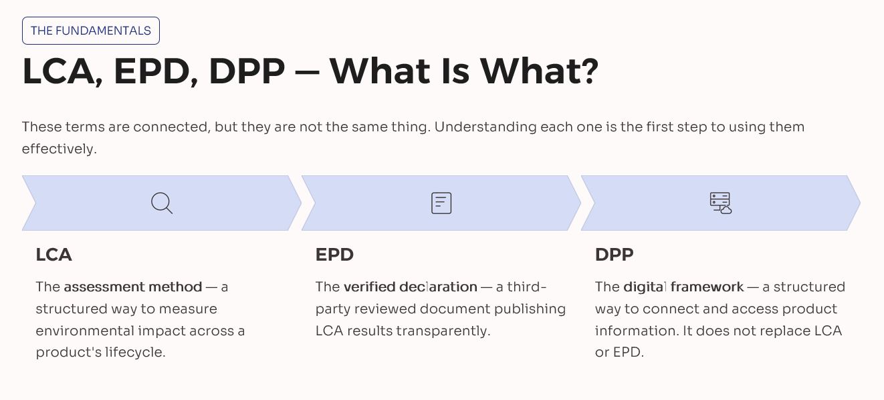
Assess → Communicate → Connect
Notes:
So, let’s start by making sense of some of the alphabet soup — LCA, EPD, DPP. What do these terms actually mean, and how do they connect?
LCA – Life Cycle Analysis
The methodology
A way of assessing the environmental impacts of a product across its lifecycle.
EPD – Environmental Product Declaration
One industry way of communicating environmental performance
A verified declaration based on LCA information, providing transparent environmental information in a consistent format.
DPP
The digital information framework
A way of connecting, accessing and sharing structured product information across the lifecycle.
“DPP does not replace LCA or EPD. It builds on information that already exists and provides a future way of connecting and sharing product information with the people who need it.”

Slide 3
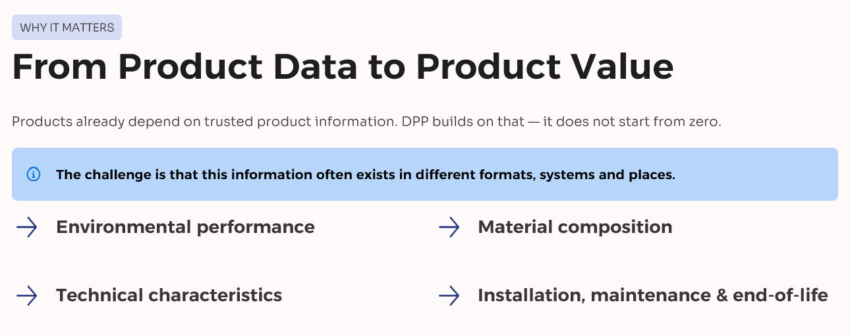
Notes:
Products already have information about:
environmental performance
material composition
technical characteristics
installation requirements
maintenance
end-of-life considerations
The challenge:
“How do we ensure that information is trusted, structured and available to the people who need it throughout the product lifecycle?”

Slide 4
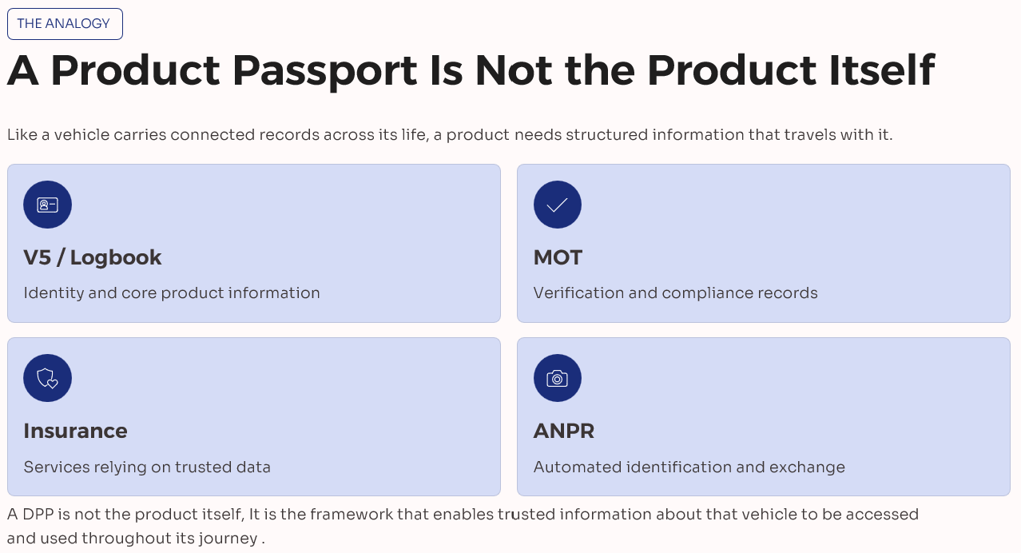

Information that follows the journey
“Information that follows the journey”
Notes:
My Transport analogy: product information that follows the journey
Like a vehicle has connected records, a product needs connected information across its lifecycle.
A vehicle has many connected records:
V5 / logbook → core product identity and manufacturer information
MOT → verification and compliance checks
Insurance → services relying on trusted information
ANPR → automated identification and data exchange
“A Digital Product Passport is not the vehicle itself. It is the framework that allows trusted information about that vehicle to be accessed and used throughout its journey.”
For products, this means information that can support decisions from manufacture, through specification and installation, to maintenance, reuse and end of life.”

Slide 5
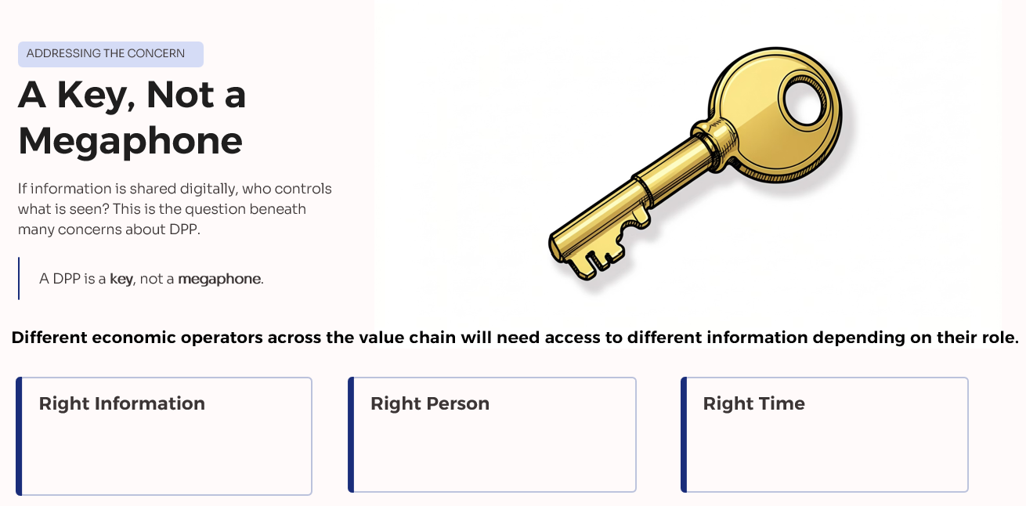
Notes:
“But this naturally raises an important question for manufacturers: if more information is being shared digitally, who controls that information?”
DPP is not about broadcasting everything it is about controlled access different users need different information commercially sensitive information should remain protected
Imagine a flooring manufacturer who has spent years refining a product — improving performance, durability and manufacturing efficiency.
When they hear about Digital Product Passports, their first reaction is often:
“Are we being asked to give away our commercial advantage?”
The answer is no.
A DPP is not a public megaphone. It is a controlled way of sharing the right information with the right economic operators and other authorised actors in the supply chain.
Different economic operators need different information at different points in the lifecycle:
A specifier or designer may need verified performance, compatability and environmental data
An installer may need product handling and fitting information
A building owner or facilities manager may need maintenance and replacement guidance
A recycler or end-of-life operator may need material composition and dismantling information
A regulator or market surveillance authority may need evidence of compliance
None of these actors need access to the manufacturer’s commercially sensitive know-how.
That is why a well-designed DPP is about structured access and role-based information, not open disclosure.
It is a key, not a megaphone.
“A DPP is not a megaphone broadcasting everything about a product. It is a key that enables controlled access to the right information for the right purpose.”
Information that follows the journey

Slide 6
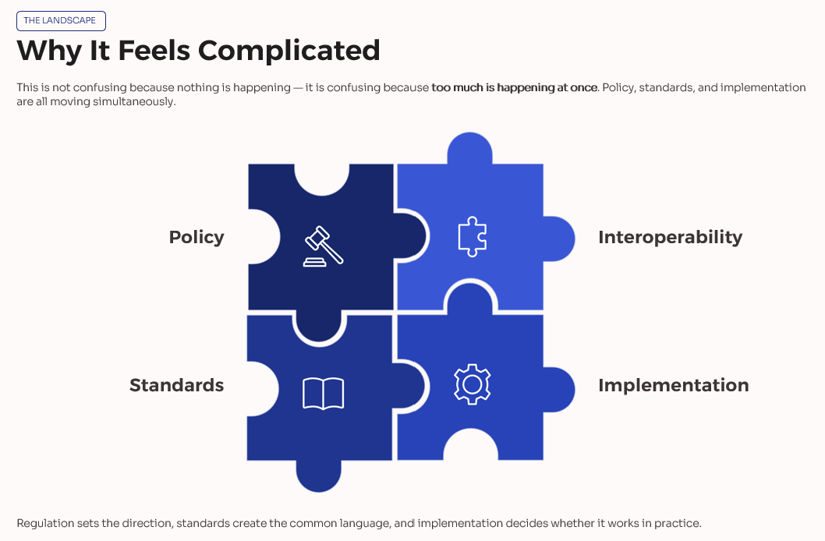
Notes:
The evolving landscape: policy, standards and implementation
Explain why people are confused.
My Message
“The reason this feels complicated is because policy, standards and implementation are developing together.”
policy sets direction
standards provide common language
implementation makes it real
interoperability will matter
Sector specific requirements will evolve over time
“Regulation sets the direction, standards create the common language and industry implementation determines whether it works in practice.”

Slide 7
Standards and EC Digital Product Passport (DPP) framework
A simple process view of how the policy mandate, standards work and international alignment fit together
1 EU policy / ESPR
1 EU policy / ESPR
2 Standards request
3 JTC 24 framework standards
4 Market use
EU policy driver
Standardisation request
Core JTC 24 standards
Implementation
ESPR sets the policy direction - Implementing the ESPR
M/604 set the DPP standardisation mandate
Unique identifiers and data carriers
Manufacturers and suppliers build compliant EU DPPs
Data exchange protocols and APIs
Harmonised standards may be cited in OJEU
Delegated acts define product-specific DPP requirements
CEN/CENELEC accepted the request and is delivering to the timetable
Some product groups will need a DPP to access the EU market – Work Plan
Interoperability, access rights, security and confidentiality
JTC 24 is the non-sector-specific framework body
This is the route into the EU market
Data authentication, reliability, integrity and persistence
Parallel alignment layer
International and UK work does not replace the EU framework, but it helps avoid fragmentation and supports interoperability across markets.
International standards alignment
ISO/IEC JTC 5, ISO/TC 154 and UNECE work alongside the European track to support cross-sector and cross-system interoperability as well as supporting supply chain and value-chain DPP usage alignment.
UK input
BSI’s IST/47/-/3 e-business committee acts as the UK mirror group and helps channel UK expert input into the European and international work. BSI allocated the responsibility for UK input into
CEN/CLC JTC 24 DPP standards to IST/47/-/3, E-business .
While driven by ESPR, the DPP framework is quickly becoming a cross-regulatory enabler - supporting implementation across CPR (Additional Info CEN/TC 442/WG 12 - Digitalization of construction products performance characteristics ), Batteries and emerging areas like Toys - signalling a broader shift toward structured product data across EU legislation. Supporting this, proposed updates to the New Legislative Framework (NLF) aim to embed digital solutions such as DPPs, aligning regulation with circular economy objectives.
DPP – Digital Product Passport, ESPR Eco-design for Sustainable Products Regulation, EU European Union, JTC Joint Technical Committee, OJEU Official Journal of the European Union, UNECE United Nations Economic Commission for Europe, ISO International Organisation for Standardisation, IEC International Electrotechnical Commission, NLF New Legislative Framework
Notes:
The evolving landscape
I said I wouldn't get complex but will park this here for you dissect later
Policy → Standards → Implementation
Policy
Defines the direction
(e.g. sustainability requirements and market expectations)
Standards
Create the common language
(identifiers, data structures, security, interoperability)
Implementation
Makes it work in practice
(manufacturers, systems, supply chains)
“Behind this picture is a significant amount of EC, CEN & international standards work, but the important point for industry is that these layers need to work together.”

Slide 8
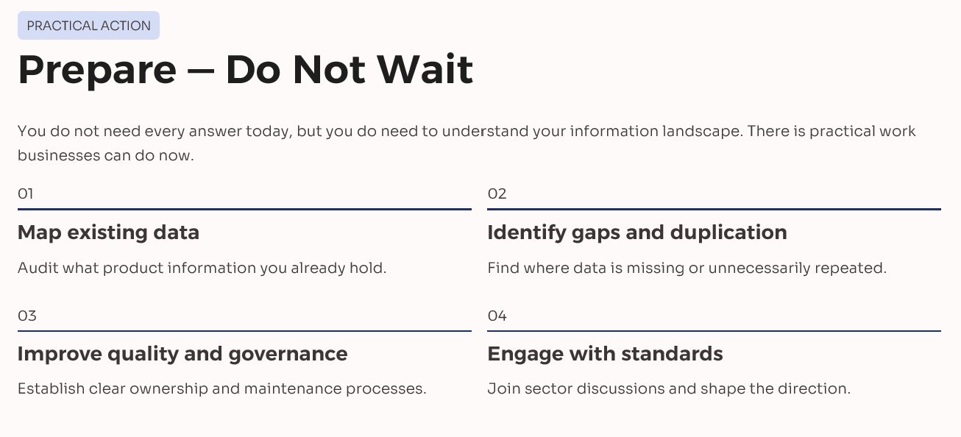
Notes:
What industry should do now
Prepare, do not wait
There is practical work businesses can do now, even without perfect clarity.
Start
map existing data
identify gaps and duplication
improve quality and governance
understand ownership and maintenance
start engaging with IMI, associations, standards and sector discussions
You do not need every answer today, but you do need to understand your information landscape.

Slide 9
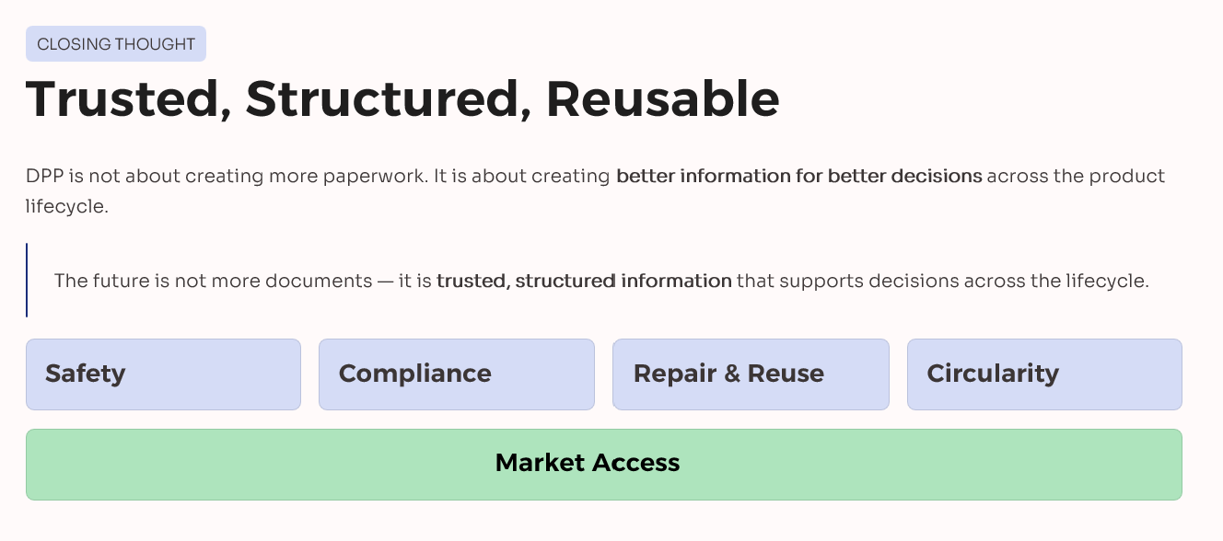
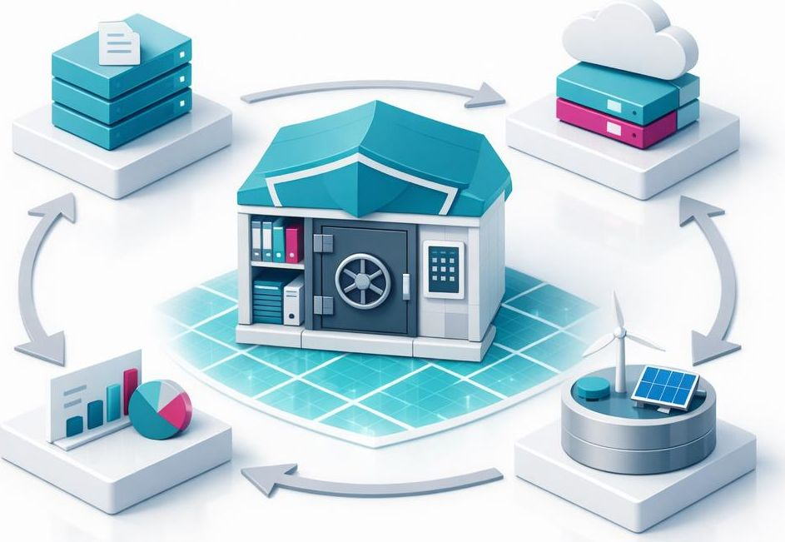
Notes:
Trusted, structured, reusable
Digital Product Passports are not about creating more paperwork. They are about turning existing product information into something trusted, structured and usable.
Helping the industry to:
make better decisions
support compliance and transparency
enable repair, reuse and circularity
Let's build confidence across the value chain
The future is not more documents. It is trusted information that can travel with the product and support better decisions throughout its lifecycle.

Slide 10

Thank You

